Slide 1
OJ-OOAD-UML: Object-Oriented Analysis and Design Using UML

Slide 2
Your Instructor
LENG Chee Kong
ckleng1964@gmail.com
019-2133329

Slide 3
Class Schedule
Duration: 4~5 Days
Class Hours: 9:00am ~ 5:00pm
Lunch Break:
Monday-Thursday: 12:30pm ~ 1:30pm
Friday: 12:30pm ~ 2:30pm
Short Breaks:
10:30am ~ 10:45am
3:30pm~3:45pm

Slide 4
Course Supporting Site
https://SECourses.AzureWebsites.net/UML

Slide 5
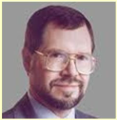
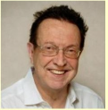
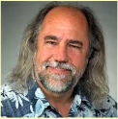
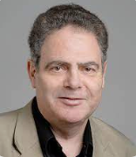
A bit of History
1990: James Rumbaugh → OOMD
1992: Ivar Jacobson → Objectory
1993: Grady Booch → OOAD and Diagrams
1995: Rational Software unites all three (“the three amigos”)
Others continue contribute to UML. Such as
Bertrand Meyer → Design by Contract
2003: IBM buy Rational

