Slide 1
Module 3:
Creating Use Case Diagrams

Slide 2
Objectives
Upon Completion of this module, you should be able to:
Justify the need for a Use Case diagram
Identify and describe the essential elements in a UML Use Case diagram
Develop a Use Case diagram for a software system based on the goals of the business owner
Develop elaborated Use Case diagrams based on the goals of all the stakeholders
Recognize and document use case dependencies using UML notation for extends, includes, and generalization
Describe how to manage the complexity of Use Case diagrams by creating UML packaged view

Slide 3
Process Map

Slide 4
Justify the Need for a Use Case Diagram
Following are reasons a Use Case diagram is necessary:
A Use Case diagram enables you to identify - by modeling - the high-level functional requirements (FRs) that are required to satisfy each user's goals.
The client-side stakeholders need a big picture view of the system.
The use cases form the basis from which the detailed FRs are developed.
Use cases can be prioritized and developed in order of priority.
Use cases often have minimal dependencies, which enables a degree of independent development.

Slide 5
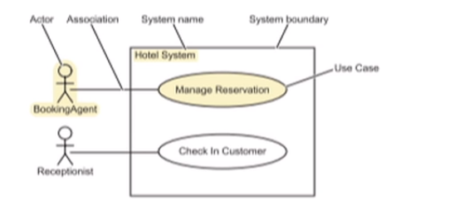
Identifying the Elements of a Use Case Diagram
A Use Case diagram shows the relationship between actors (roles) and the goals they wish to achieve.
A physical job title can assume multiple actors (roles).

Slide 6
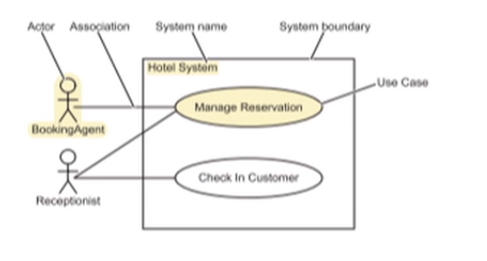
Identifying the Elements of a Use Case Diagram
This diagram illustrates an alternative style that explicitly shows an association between the Receptionist actor (role) and the Manage Reservation use case.

Slide 7
Actors
An actor:
Models a type of role that is external to the system and interacts with that system
Can be a human, a device, another system, or time.
Can be primary or secondary
Primary: Initiates and controls the whole use case
Secondary: Participates only for part of the use case
A single physical instance of human, a device, or a system may play the role of several different actors

Slide 8
Actors

Slide 9
Use Cases
A use case describes an interaction between an actor and the system to achieve a goal.
A use case encapsulates a major piece of system behavior with a definable outcome.
A use case is represented as an oval with the use case title in the center.
A good use case title should consist of a brief but unambiguous verb-noun pair.
A use case can often be UI independent.

Slide 10
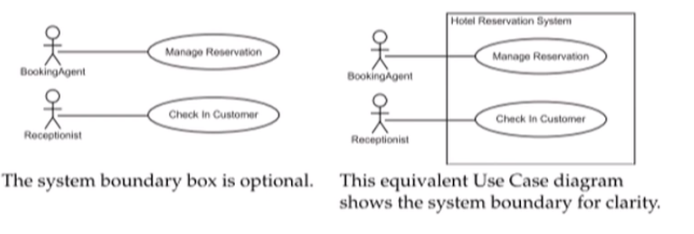
System Boundary
The use cases may optionally be enclosed by a rectangle that represents the system boundary.

Slide 11
Use Case Associations
A use case association represents "the participation of an actor in a use case." (UML v1.4 spec. page 357)
An actor must be associated with one or more use cases.
An use case must be associated with one or more actors.
An association is represented by a solid line with no arrowheads. However, some UML tool use arrows by default.

Slide 12
Creating the Initial Use Case Diagram
One of the primary aims of the initial meeting with the project's business owner is to identify the business-significant use cases.
A use case diagram may be created during the meeting.
Alternatively, the diagrams can be created after the meeting from textual notes.
The next two slides present some text showing an abstract of the use-case-specific topics discussed during the meeting.

Slide 13
Creating the Initial Use Case Diagram

Slide 14
Creating the Initial Use Case Diagram

Slide 15
Creating the Initial Use Case Diagram

Slide 16
Identifying additional Use Cases
During the meeting with the business owner, you will typically discover 10 to 20 percent of the use cases needed for the system.
During the meeting with the other stakeholders, you will discover many more use case titles that you can add to the diagram. For examples:
Maintain Rooms
Create, Update, and Delete
Maintain RoomTypes
Create, Update, and Delete

Slide 17
Identifying additional Use Cases
The time of discovery depends upon the development process.
In a non-iterative process:
You ideally need to discover all of the remaining use case titles, bringing the total to 100%.
However, this is a resource-intensive task and is rarely completely accurate.

Slide 18
Identifying additional Use Cases
In an iterative/incremental development process, an option is to:
Discover a total of 80% of the use case titles in the next few iterations for 20% of the effort. This is just one of the many cases of the 80/20 rule.
Discover the remaining 20% of the use case titles in the later iterations for minimal effort.
This process works well with software that is built to accommodate change.

Slide 19
Use Case Elaboration
During the meeting with the other stakeholders, you will discover many more use cases that you can add to the diagram.
You might also find that some use cases are too high-level. In this case, you can introduce new use cases that separate the workflows.

Slide 20
Expanding High-Level Use Cases
Typically, managing an entity implies being able to Create, Retrieve, Update, and Delete an entity (so called, CRUD operations). Other keywords include:
Maintain
Process
Other high-level use cases can occur. Identify these by analyzing the use case scenarios and look for significantly divergent flows.
If several scenarios have a different starting point, these scenarios might represent different use cases.

Slide 21
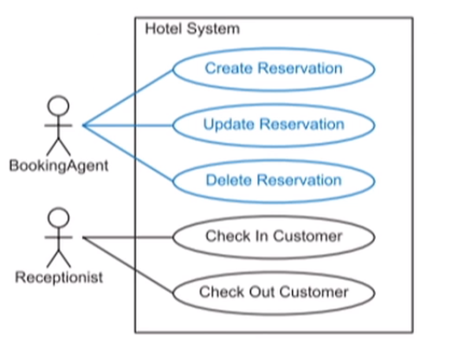
Expanding High-Level Use Cases
The expended diagram:

Slide 22
Analyzing Inheritance Patterns
Inheritance can occur in Use Case diagrams for both actors and use cases:
An actor can inherit all of the use case associations from the parent actor.
A use case can be subclassed into multiple, specialized use cases.

Slide 23
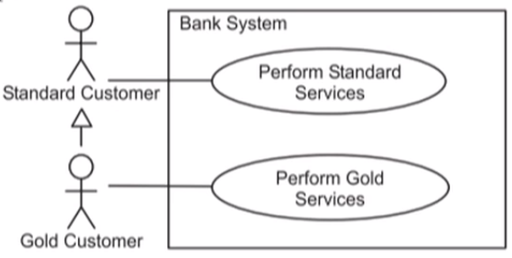
Actor Inheritance
An actor can inherit all of the use case associations from the parent actor
This inheritance should be used only if you can apply the "is a kind of" rule between the actors

Slide 24
Use Case Specialization
A use case can be subclassed into multiple, specialized use cases:
Use case specializations are usually identified by significant variants in the use case scenarios.
If the base use case cannot be instantiated, you must mark it as abstract.

Slide 25
Analyzing Use Case Dependencies
Use cases can depend on other use cases in two ways:
One use case (a) includes another use case (i).
This means that the one use case (a) requires the behavior of the other use case (i) and always performs the included use case.
One use case (e) can extend another use case (b).
This means that the one use case (e) can (optionally) extend the behavior of the other use case (b)

Slide 26
The <<include>> Dependency
The include dependency enables you to identify behaviors of the system that are common to multiple use cases.
This dependency is drawn like this:

Slide 27
The <<include>> Dependency
Identify and recording common behavior:
Review the use case scenarios for common behaviors.
Give this behavior a name and place it in the Use Case diagram with an <<include>> dependency.

Slide 28
The <<include>> Dependency
Identifying behavior associated with a secondary actor:
Review the use case scenarios for significant behavior that involves a secondary actor.

Slide 29
The <<include>> Dependency
Split the behavior that interacts with this secondary actor. Give this behavior a Use Case title, and place it in the Use Case diagram with an <<include>> dependency.

Slide 30
The <<extend>> Dependency
The extend dependency enables you to identify behaviors of the system that are not part of the primary flow, but exist in alternate scenarios.
This dependency is drawn like this:

Slide 31
The <<extend>> Dependency
Identifying and recording behaviors associated with an alternative flow of a use case:
Review the use case scenarios for significant and cohesive sequences of behavior.
Give this behavior a <<extend>> dependency.

Slide 32
A Combined Example

Slide 33
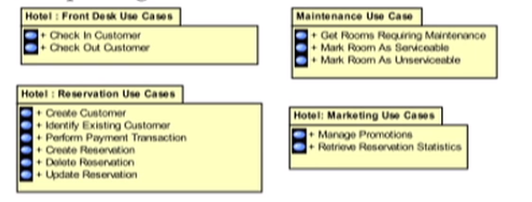
Packaging the Use Case Views
It should be apparent that any non-trivial software development would need more use cases than could be viewed at one time. Therefore, you need to be able to manage this complexity.
One way of managing this complexity is to break down the use cases into packages.

Slide 34
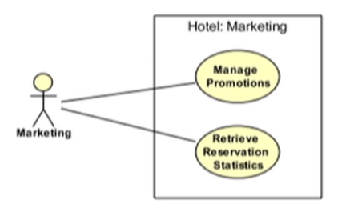
Packaging the Use Case Views
You can look inside each package to reveal the detailed content.
A use case element may exist in multiple packages, where it participates in multiple views.

Slide 35
Packaging the Use Case Views

Slide 36
Summary
A Use Case diagram provides a visual representation of the big-picture view of the system.
The Use Case diagram represents the actors that use the system, the use cases that provide a behavior with a definable goal for an actor, and the associations between them.
Use Case diagrams can be elaborated to show a software system based on the goals of the business owner and all the other stakeholders.

