Slide 1
Module 4 (Part-1):
Creating Use Case Scenarios and Forms

Slide 2
Objectives
Upon Completion of this module, you should be able to:
Identify the document scenarios for a use case.
Create a Use Case form describing a summary of the scenarios in the main and alternate flows
Describe how to reference included and extending use cases.
Identify and document non-functional requirements (NFRs), business rules, risks, and priorities for a use case
Identify the purpose of a Supplementary Specification Document.

Slide 3
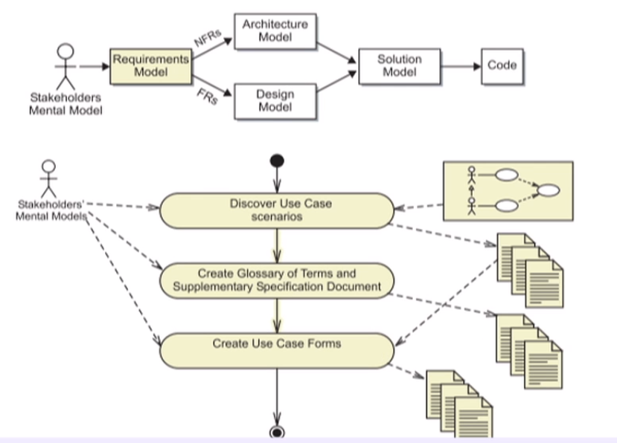
Process Map

Slide 4
Recording Use Case Scenarios
A Use Case Scenario is a concrete example of a use case.
A Use Case scenario should:
  Be as specific as possible
  Never contain conditional statements
  Begin the same way but have different outcomes
  Not specify too many use interface details
  Show successful as well as unsuccessful outcomes (in different scenarios)
Use Case scenarios drive several other OOAD workflows.

Slide 5
Selecting Use Case Scenarios
While it is ideal to have multiple scenarios for all use cases, doing so would take a lot of time. Therefore, you can select appropriate scenarios by the following criteria:
The use case involves a complex interaction with the actor
The use case has several potential failure points, such as an interaction with external systems or a database.
There are two types of scenarios:
Primary (Happy) scenarios record successful results.
Secondary (Sad) scenarios record failure events.

Slide 6
Writing a Use Case Scenario
A Use Case scenario is a story that:
Describe how an actor uses the system and how the system responds to the actions of the actor.
Has a beginning, a middle, and an end.

Slide 7
Primary Use Case Scenario: Example
The beginning:
  The use case begins when the booking agent receives a request to make a reservation for rooms in the hotel.

Slide 8
Primary Use Case Scenario: Example
The middle:
  The booking agent enters the arrival date, the departure date, and the quantity of each type of room that is required. The booking agent then submits the entered details. The system finds rooms that will be available during the period of the rooms from the available rooms. The system responds that the specified rooms are available, returns the provisional reservation number, and marks the reservation as "held". The booking agent accepts the rooms offered.

Slide 9
Primary Use Case Scenario: Example
More of the middle:
  The booking agent selects that the customer has visited one of the hotels in this group before, and enters the zip code and customer name. The system finds and returns a list of matching customers with full address details. The booking agent selects one of the customers as being the valid customer. The system assign this customer to the reservation. The cooking agent performs a payment guarantee check. This check is successful.

Slide 10
Primary Use Case Scenario: Example
The end:
  The system assigns the payment guarantee to the reservation and changes the state of the reservation to "confirmed". The system returns the reservation ID and booking details.

Slide 11
Secondary Use Case Scenario: Example
The beginning:
The use case begins when the booking agent receives a request to make a reservation for rooms in the hotel.
The middle:
The booking agent enters the arrival date, the departure date, and the quantity of each type of room that is required. The booking agent then submits the entered details. The system responds that there are no rooms available of any type for the date range specified in the request.
The end:
The use case ends.

Slide 12
Supplementary Specifications
Some of the project information that you gather cannot be stored with the use cases because this information needs to be shared by several use cases.
This additional information can be documented in a Supplementary Specification Document, which often contains:
  NFRs
  Project Risks
  Project Constraints
  Glossary of Terms

Slide 13
Non-Functional Requirements (NFRs)
Non-functional requirements (NFRs) define the qualitative characteristics of the system. As in an animal, the NFRs describe strength, speed, and agility of the internal features of the animal. How fast can the animal move? How much weigh can the animal carry?
Any adverbial phrase can be an NFR

Slide 14
NFRs: Examples
NFR1:The system must support 200 simultaneous users in the Web application.
NFR2:The process for completing any reservation activity must take the average user no more than 10 minutes to finish.
NFR3: The capacity of reservation records could grow to 2,600 per month.
NFR4:The Web access should use the HTTPS transport layer when critical customer information is being communicated.
NFR5:The numerical accuracy of all financial calculations (for example, report and customer receipts) should follow a 2-significant-digit precision with standard rounding of intermediate results.

Slide 15
NFRs: Examples
NFR6:The System must be available "7 by 24 by 365". However, the application can be shut down for maintenance once a week for one hour. This maintenance activity should be scheduled between 3am and 6pm.
NFR7:Based on historical evidence, there are approximately 600 reservations per month per property.
NFR8:The search for available rooms must take no longer than 30 seconds.

Slide 16
Glossary of Terms
The Glossary of Terms defines business or IT terms that will be used in the project.
This is a living document, which should be appended with new terms, or amended if a term is found to be incorrect or needs redefinition.

Slide 17
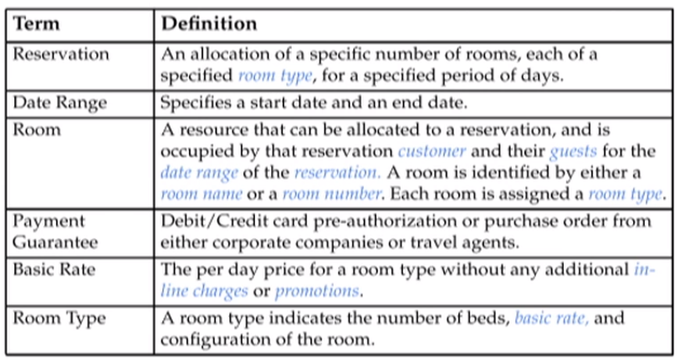
Glossary of Terms: Example

