Slide 1
Module 4 (part 2):
Creating Use Case Scenarios and Forms

Slide 2
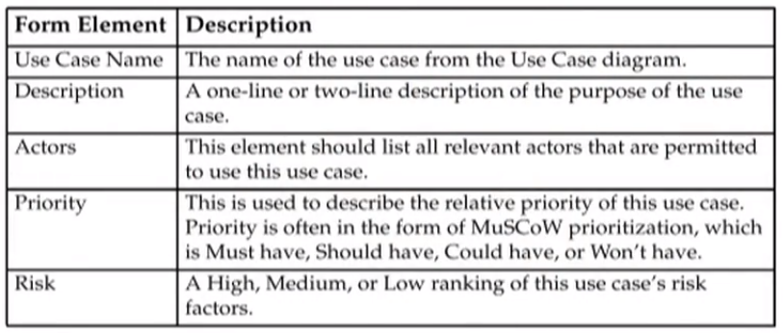
Description of a Use Case Form
A Use Case form provides a tool to record the detailed analysis of a single use case and its scenarios.

Slide 3
Description of a Use Case Form

Slide 4
Description of a Use Case Form

Slide 5
Description of a Use Case Form
Some methodologies recommend more or less analysis of the use case. The analysis workflow presented in this module tends to be more detailed.
Use Case forms are not standard. There are different styles that can be used to create a Use Case form

Slide 6
Creating a Use Case Form
Steps to determine the information for the Use Case form:
Determine a brief description from the primary scenarios.
Determine the actors who initiate and participate in this use case from the Use Case diagrams.
Determine the priority of this use case from discussions with the stakeholders.
Determine the risk from scenarios and from discussions with the stakeholders.
Determine the extension points from the Use Case diagrams.
Determine the pre-conditions from the scenarios.
Determine the trigger from the scenarios.

Slide 7
Creating a Use Case Form
Determine the flow of event from the primary (happy) scenarios.
Determine the alternative flows from the secondary (sad) scenarios.
Determine the business rules from scenarios and from discussions with stakeholders.
Determine the post-conditions.
Determine the new NFRs from discussions with stakeholders.
Add notes for information - gathered from discussions with stakeholders - that does not fit into the standard sections of the form.

Slide 8
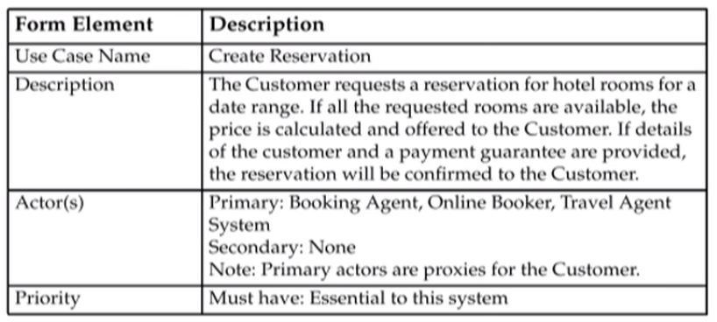
Fill in Values for the Use Case Form
Fill in elements derived from stakeholders and previous artifacts

Slide 9
Fill in Values for the Use Case Form

Slide 10
Fill in Value for the Main Flow of Events

Slide 11
Fill in Value for the Alternative Flow of Events
Determine the alternative flows from the secondary scenarios and remaining primary scenarios:
Perform a different analysis between the scenarios used for the main flow and each of the other scenarios (in turn).
The alternative flows are the steps that are different between the scenario used for the main flow and each of the other scenarios.

Slide 12
Fill in Value for the Alternative Flow of Events

Slide 13
Fill in Value for the Alternative Flow of Events

Slide 14
Fill in Values for the Business Rules

Slide 15
Summary
A Use Case scenario is written to provide a detailed description of the activities involved in one instance of the use case.
Use Case scenarios should provide as many different situations as possible so that the whole range of activities for that use case are documented.
Use Case scenarios provide much detail about a use case. An analysis of this detail is recorded in the Use Case form.
The activities of a use case are distill into Flow of Events portion of the Use Case form. Alternative flows are identified from unusual situations in one or more scenarios.

