Slide 1
Module 5:
Creating Activity Diagrams

Slide 2
Objectives
Upon Completion of this module, you should be able to:
Identify the essential elements of an Activity Diagram
Model a Use Case flow of events using an Activity diagram.

Slide 3
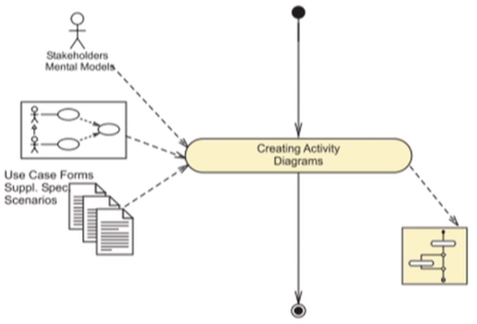
Process Map

Slide 4
Describing a Use Case with an Activity Diagram
To verify a mental model of a Use Case you can:
Model the flow of events of an Use Case in an Activity diagram.
Validate the Use Case by reviewing the Activity diagram with the stakeholders.

Slide 5
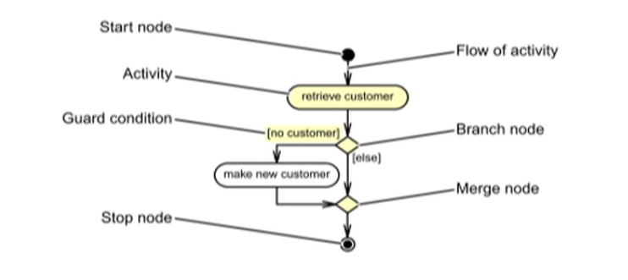
Identifying the Elements of an Activity Diagram
An Activity diagram is composed of the following elements:

Slide 6
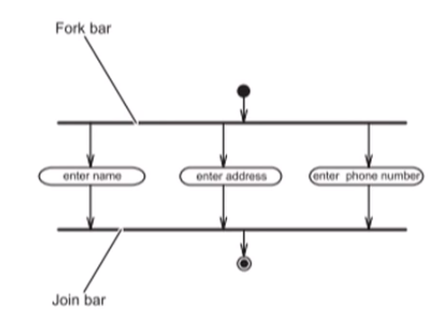
Identifying the Elements of an Activity Diagram
An example of concurrent activities:

Slide 7
Activity and Actions
Activities and actions are processes taken by the system or an actor.
Activity nides and action nodes use the same notation in UML.
An activity can be divided into other activities or actions.
An action is an activity node which cannot be divided within the context of the current view.
A primitive form of action results in a change in the state of the system or the return of a value.

Slide 8
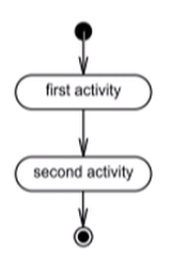
Flow of Control
An Activity diagram must start with a Start node and end with a Stop node. Flow of control is indicated by the arrows that link the activities together.

Slide 9
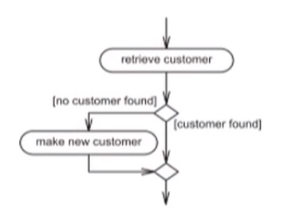
Branching
The branching and merge nodes represent conditional flows of activity.
A branch node has two or more outflows, with Boolean predicates to indicate the selection condition.
A merge node collapses conditional branches.

Slide 10
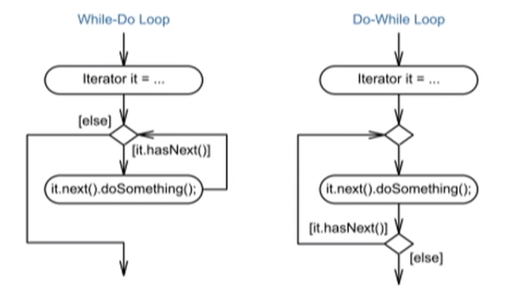
Iteration
Iteration can be achieved using branch nodes.

Slide 11
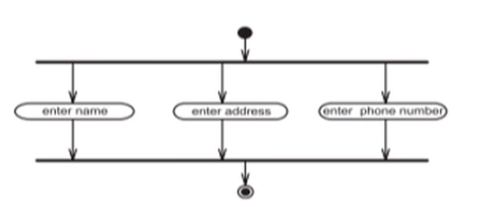
Concurrent Flow of Control
The fork and join bars indicate concurrent flow of control.
Fork and join bar can represent either threaded activities or parallel use activities.
The multiplicity indicator specifies how many of the parallel activities must have been processed.

Slide 12
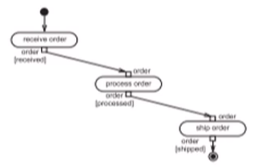
Passing an Object between Actions
An Activity diagram can show objects being passed between actions.
A pin is a connection point of an action for object input or output.
The name of the pin denotes the object being passed.

Slide 13
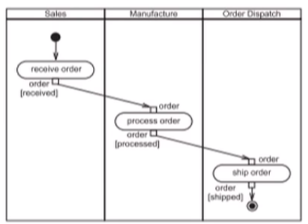
Partitions in Activity Diagrams
An Activity diagram can show objects grouped into partitions (formerly called swimlanes)
Partitions can be vertical, horizontal or both.

Slide 14
Signals in Activity Diagrams
An Activity diagrams can show the receiving and sending of signals.
An Accept Event Action element or an Accept Time Event element is used to show the receiving of a signal.
A Send Event Action element is used to show the sending of a signal.

Slide 15
Displaying Signals in Activity Diagrams

Slide 16
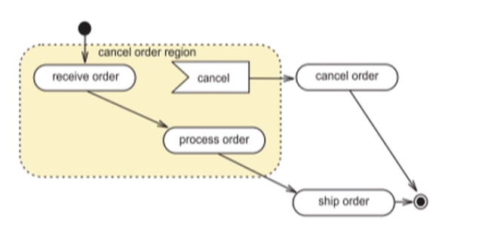
Interruptible Activity Regions
An Activity diagram can show a subset of activities that can be interrupted by an event.

Slide 17
Creating an Activity Diagram for a Use Case
Analyze the flow of events field in the Use Case form:
Identify activities.
Identify branching and looping.
Identify concurrent activities.

Slide 18
Creating Activity Diagrams - Example 1
The following slide illustrates a simple sequence of activities for a part of the Create Reservation Use Case.
The diagram shows the activities involved in identifying the customer:
by either delegating the entry of the new customer details to the extension point (New Customer)
or by the actor entering a subset of customer information in order to find the existing customer.
If no existing customer is found then the extension point (New Customer) is used.

Slide 19
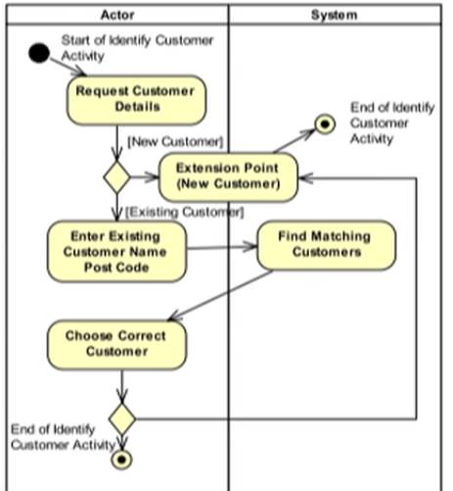
Creating Activity Diagrams - Example 1

Slide 20
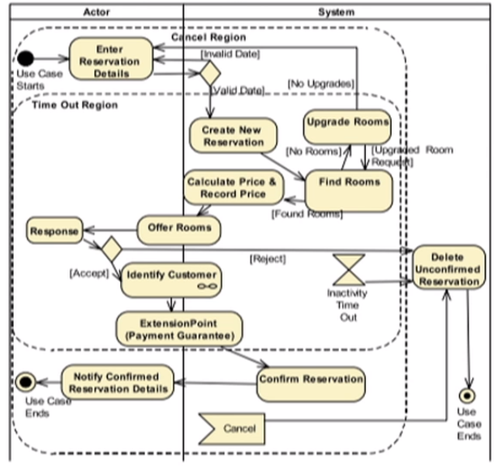
Creating Activity Diagrams - Example 2

