Slide 1
Module 6:
Determining the Key Abstractions

Slide 2
Objectives
Upon Completion of this module, you should be able to:
Identify a set of candidate key abstractions.
Identify key abstractions using CRC (Class Responsibility Collaboration ) analysis.

Slide 3
Process Map

Slide 4
Introducing Key Abstractions
"A key abstraction is a class or object that forms part of the vocabulary of the problem domain." (Booch OOAD page 162)
Represents the primary objects within the system. Finding key abstractions is a process of discovery.
Identify all candidate key abstractions by listing all nouns from the project artifacts in a "Candidate Key Abstractions Form."
Use CRC analysis to determine the essential set of key abstractions.
Key abstractions are recognized as objects that have responsibilities and are used by other objects (the collaborators).

Slide 5
Identifying Candidate Key Abstractions
Begin the process of identifying all of the unique nouns in the project artifacts by focusing on the following areas in these documents:
The Main Flow and Alternative Flow sections of the use case forms.
The other sections of the use case forms.
The use case scenarios
The Glossary of terms
The Supplementary Specification document
Tip: With practice you will be able to skip some of the nouns that are obviously not part of the domain.

Slide 6
Identifying the Candidate Abstractions
Here are a few excepts from the Hotel System artifacts with the nouns marked in yellow:
From the Create Reservation Use Case Form Description Section:
The Customer requests a reservation for hotel rooms for a data range. If all the requested rooms are available, the price is calculated and offered to the Customer. If details of the customer and a payment guarantee are provided, the reservation will be confirmed to the Customer.

Slide 7
Identifying the Candidate Abstractions
From the Create Reservation Use Case Form Main Flow Section:
Customer enters types of rooms, arrival date, and departure date
System creates a reservation and reserves rooms
System calculates quoted price
System records quoted price
System notifies Customer of reservation details (including rooms and price)
Customer accepts rooms offered
Extension Point (new customer)
Extension Point (payment guarantee)
System changes reservation status to "confirmed"
System notified Customer of confirmed reservation details

Slide 8
Identifying the Candidate Abstractions
From the Create Reservation Use Case Form Alternative Flow Section:
Customer can enter duration instead of departure date
Failed date check BR1. Notify error to Customer
Complying with BR2, System determines that required rooms are not available
System upgrades one or more room types
No further upgrades available. Notify message to Customer rooms offered are declined
Customer already exists, Customer enters customer name & zip code
System searches for matching customers, notifies Customer of matching customers, Customer selects correct customer details
Payment guarantee fails. Notify message to Customer
Existing customer not found
Reservation not confirmed, reservation deleted

Slide 9
Identifying the Candidate Abstractions
From the Create Reservation Use Case Form Business Rule Section:
The arrival date must not be before today's date, and the departure date must be after the arrival date
Reservations with assigned rooms but no payment guarantee have a status of "held"
Reservations with status of "confirmed" must be linked to a payment guarantee and customer
Reservation must not exist without being linked to at least one room

Slide 10
Identifying the Candidate Abstractions
From the Create Reservation Use Case Form Remaining Sections:
...
From the Supplementary Specification Documents. For example the Project Glossary:
Reservation: An allocation of a specific number of rooms, each of a specific room type, for a specific period of days
Date Range: Specifies a start date and an end date

Slide 11
Identifying the Candidate Abstractions
The form for recording candidate key abstractions use three fields:
Candidate Key Abstraction: This field contains a noun discovered from the project artifacts
Reason for Elimination: This field is left blank if the candidate becomes a key abstraction. Otherwise, this field contains the reason why the candidate was rejected
Selected Name: This field contains the name of class if this entry is selected as a key abstraction.

Slide 12
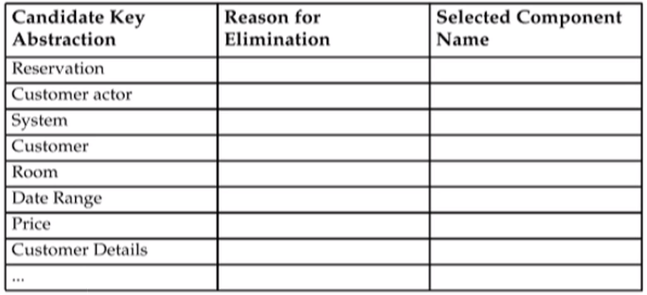
Candidate Key Abstractions Form (Example)

Slide 13
Project Glossary
The process of identifying candidate key abstractions is also a good opportunity to verify that your project glossary is up-to-date.
Verify that all domain-specified terms have been listed and defined
Identify synonyms in the project glossary and select a primary term to use throughout the documentation and source code

Slide 14
Discovering Key Abstractions using CRC Analysis
After you have a complete list of candidate key abstractions, you need to filter this list. One technique is CRC analysis:
Select one candidate key abstraction
Identify a use case in which this candidate is prominent
Scan the use case forms, use case scenarios to determine responsibility and collaborators
Scan the Glossary for all references to the noun
Document this key abstraction with a CRC card
Update Candidate Key Abstractions Form based on findings

Slide 15
Selecting a Key Abstraction Candidate
Selecting a good key abstraction candidate is largely intuition, but here are a few tactics:
Ask a domain expect
Choose a candidate key abstraction that is used in a use case name
Choose a candidate key abstraction that is used in as use case form

Slide 16
Selecting a Key Abstraction Candidate
The noun "reservation" appears many times in the following areas:
In the following use case names:
Create Reservation
Update Reservation
Delete Reservation
In many places throughout the use case forms. For examples, the Check In Customer use case form will describe assigning a bill to a Reservation

Slide 17
Identifying a Relevant Use Case
To determine whether the candidate key abstraction is a real key abstraction, you must determine if the candidate has any responsibilities and collaborators
To identify a use case that might declare a candidate's responsibilities and collaborators:
Scan the use case names for the candidates key abstraction
Scan the use case forms for the candidate key abstraction
Scan the use case scenarios for the candidate key abstraction
Scan the text of the use case scenarios to see if the candidate key abstraction is mentioned

Slide 18
Identifying a Relevant Use Case
As mentioned previously, there are three use cases that focus on the reservation key abstraction:
Create Reservation
Update Reservation
Delete Reservation

Slide 19
Updating the Candidate Key Abstractions Form

Slide 20
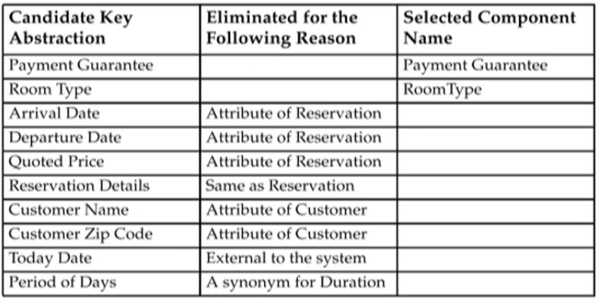
Updating the Candidate Key Abstractions Form

