Slide 1
Module 7 (Part-1):
Constructing the Problem Domain Model

Slide 2
Objectives
Upon Completion of this module, you should be able to:
Represent the relationships of the key abstractions in the Domain Model.
Verify the Domain Model using Object Diagrams from UC scenarios.

Slide 3
Process Map

Slide 4
Introducing the Domain Model
Domain model - "The sea of classes in a system that serves to capture the vocabulary of the problem space; also known as aconceptual model." (Booch Object Solutions page 304)
The classes in the Domain model are the system’s key abstractions
The Domain model shows relationships (callaborators) between the key abstractions
3 main Views in Requirement Model:
Use Case Model
Supplementary Specification Document
Domain Model

Slide 5
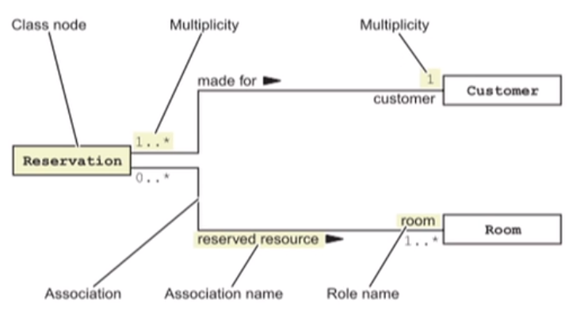
Identifying the Elements of a Class Diagram
A UML Class diagram is composed of the following elements:

Slide 6
Class Nodes
Class nodes represent classes of objects within the model.
These can represent:
Conceptual entities such as key abstractions
Real software components
A stereotype can help identify the type of the class node

Slide 7
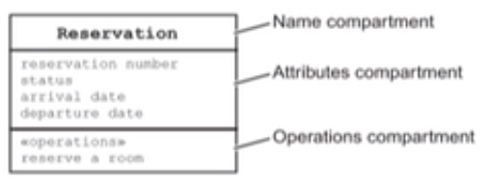
Class Node Compartments
The name compartment records the name of the class
The attributes compartment records attributes (or instance variables) of the class
The operations compartment records operations (or methods) of the class/instance of class
Additional compartments may be added

Slide 8
Associations
Associations represent relationships between classes
Associations are manifested at runtime, but these models represent all possible runtime arrangements between objects
This association would be read as "A reservation is made for a customer."

Slide 9
Multiplicity
Multiplicity/Cardinality determines how many objects might participate in the relationship
This association would be read as "A reservation is made for one and only one customer." Read it in the other direction is "A customer can make one or more reservations."

Slide 10
Navigation
Navigation arrows on the association determine what direction an association can be traversed at runtime
For example:
This association would be read as "From a reservation the system can directly retrieve the room, and from a room the system cannot directly retrieve the reservation for that room."

Slide 11
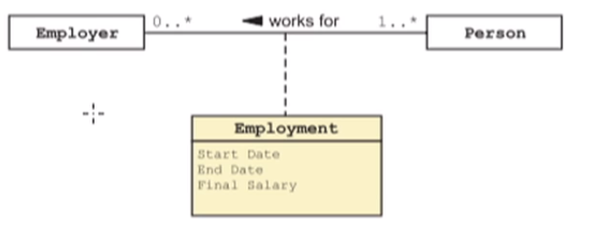
Association Classes
Sometimes information is included in the association between two classes.
For example:
Employment is an association class that records the employment details for each term of employment between a person and an employer

Slide 12
Creating a Domain Model
Starting with the key abstractions, you can create a Domain model using these steps:
Draw a class node for each key abstraction, and:
List known attributes
List know operations
Draw associations between collaborating classes
Identify and document relationship and role names
Identify and document association multiplicity
Optionally, identify and document association navigation.

Slide 13
Step 1 - Draw the class Nodes

Slide 14
Step 2 - Draw the Associations

Slide 15
Step 3 - Label the Associations and Role Names

Slide 16
Step 4 - Label the Association Multiplicity

Slide 17
Step 5 - Draw the Navigation Arrows

