Slide 1
Module 7 (Part-2):
Constructing the Problem Domain Model

Slide 2
Objectives
Upon Completion of this module, you should be able to:
Create Object Diagram
Verify the Domain Model using Object Diagrams from UC scenarios.

Slide 3
Validating the Domain Model (Intro)
You can validate the Domain Model by analyzing multiple Object Diagrams based on use case scenarios
First, the essential elements of Object Diagrams are presented

Slide 4
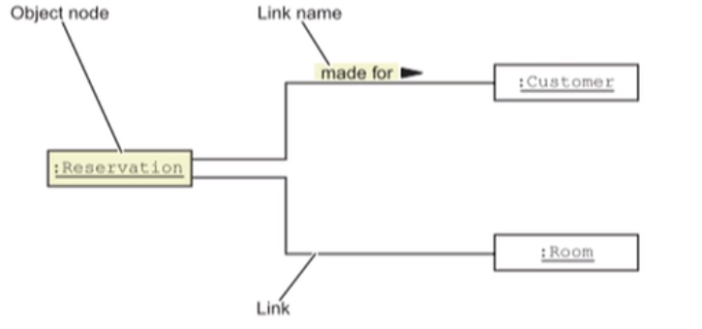
Identifying the Elements of an Object Diagram
"A static object diagram is an instance of a class diagram; it shows a snapshot of the detailed state of a system at a point in time."
(UML specv1.4, page 3-35)

Slide 5
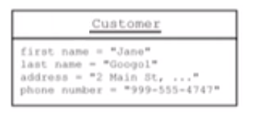
Object Nodes
An Object Node includes some form of name and data type:
An Object Node might also include attributes:

Slide 6
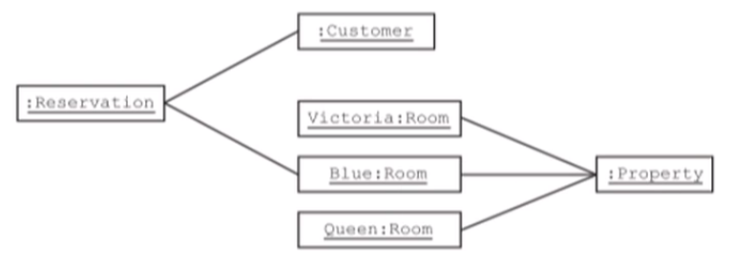
Links
In Object Diagrams each link is unique and is one-to-one with respect to the participants.
For example:

Slide 7
Validating the Domain Model using Object Diagrams
Place one or more cases that exercise the Domain Model
Pick one or more use case scenarios for the selected use cases
Walk through each scenario (separately), and construct the objects (with data) mentioned in the scenario
Compare each Object Diagram against the Domain Model to see if any association constraints are violated

Slide 8
Step 1 - Create Reservation Scenario 1
The use case begins when the booking agent receives a request to make a reservation for rooms in the hotel. The booking agent enters the arrival date, the departure date, and the quantity of each type of room that is required

Slide 9
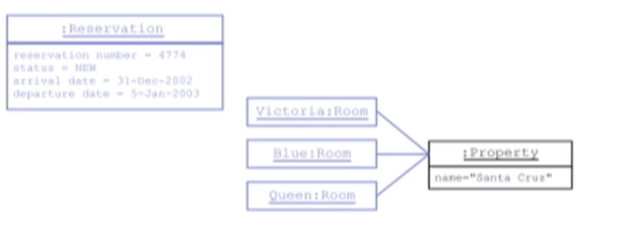
Step 2 - Create Reservation Scenario 1
The booking agent then submits the entered details. The system finds rooms that will be available during the period of the reservation

Slide 10
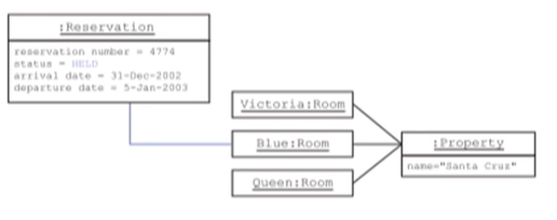
Step 3 - Create Reservation Scenario 1
The system allocates the required number and type of rooms from the available rooms. The system responds that the specified rooms are available, returns the provisional reservation number, and marks the reservation as "held"

Slide 11
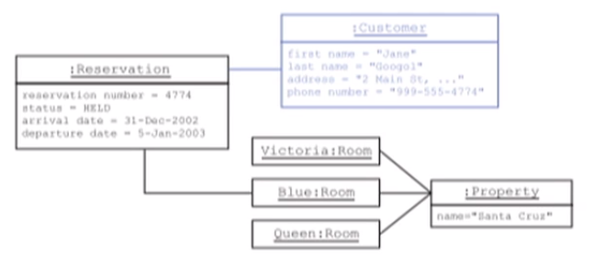
Step 4 - Create Reservation Scenario 1
The booking agent accepts the rooms offered. The booking agent selects that the customer has visited one of the hotels in this group before, and enters the zip code and customers name. The system finds and returns a list of matching customers with full address details. The booking agent selects one of the customers as being the valid customer. The system assigns this customer to the reservation

Slide 12
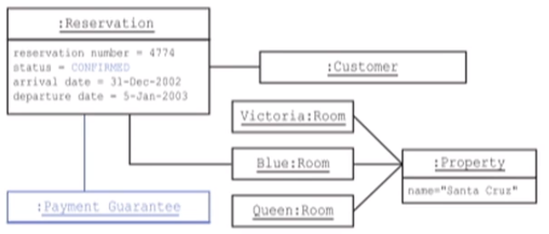
Step 5 - Create Reservation Scenario 1
The booking agent performs a payment guarantee check. This check is successful. The system assigns the payment guarantee to the reservation and changes the state of the reservation to "confirmed". The system returns the reservation ID and booking details

Slide 13
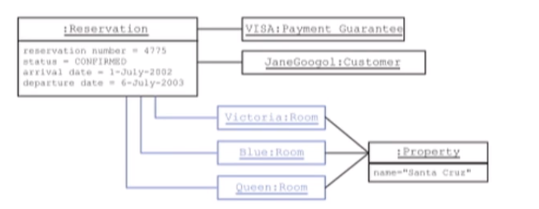
Create Reservation Scenario 2
Another "Create a Reservation" scenario has the Actor making a reservation from a small family reunion in which three rooms are booked:

Slide 14
Comparing Object Diagrams to Validating the Domain Model
To validate the Domain Model, compare the Class Diagram with the scenario Object Diagrams
Are there attributes or responsibilities mentioned in a scenario that are not listed in the Domain Model?
Are three associations in the Object Diagrams that do not exist in the Domain Model?
Are there scenarios in which the multiplicity of a relationship is wrong?

Slide 15
Revised Domain Model for the Hotel Reservation System

