Slide 1
Module 8 (Part-1):
Transitioning from Analysis to Design Using Interaction Diagrams

Slide 2
Objectives
Upon Completion of this module, you should be able to:
Explain the purpose and elements of the Design Model
Identify the essential elements of a UML Communication Diagram
Create a Communication Diagram View of the model
Identify the essential elements of a UML Sequence diagram
Create a Sequence Diagram View of the Design Model

Slide 3
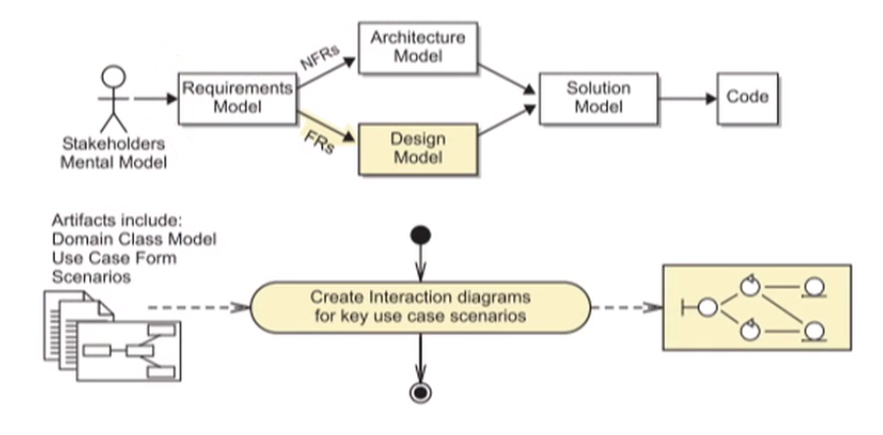
Process Map

Slide 4
Introducing the Design Model
The Design Model is created from the Requirements Model (Use Cases and Domain Model)
The Design Model is merged with the Architecture Model to produce the Solution Model

Slide 5
Interaction Diagrams
Each UML Interaction Diagram is used to show the sequence of interactions that occur between objects during:
One or two use cases scenarios
A fragment of one use case scenario
UML Interaction Diagrams may also be used to show the sequence of interactions that occur between:
Systems
Subsystems

Slide 6
Comparing Analysis and Design
Analysis helps you model what is know about a business process that the system must support
Use Cases
Domain Model
Design helps you model how the system will support the business processes. The Design Model consists of:
Boundary (UI) Components
Service Components
Entity Components

Slide 7
Robustness Analysis
Robustness Analysis is a process that assists in identifying design components that would be required in the Design Model:

Slide 8
Robustness Analysis
Inputs to Robustness Analysis:
A use case
The use case scenarios for that use case
The use case Activity Diagram (if available) for that use case
The Domain Model
Output from Robustness Analysis:
The Design Model is usually captured in UML Interaction Diagrams with design components such as Boundary, Service, and Entity Components

Slide 9
Boundary Components
"A boundary class (component) is used to model interaction between the system and its actors (that is, users and external systems)."
(Jacobson, Booch, and Rumbaugh page 183)
Abstractions of UI screen, sensors, communication interfaces, and so on
High-level UI components
Every boundary components must be associated with at last one actor

Slide 10
Service Components
"Control (Service) classes (components) represent coordination, sequencing, transactions, and control of other objects and are often used to encapsulate control related to a specific use case."
(Jacobson, Booch, and Rumbaugh page 185)
Coordinate control flow
Isolate any changes in workflow from the boundary and entity components

Slide 11
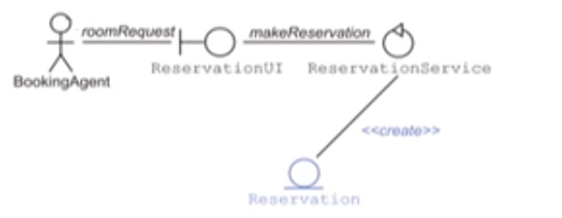
Entity Components
"An entity class (component) is used to model information that is long-lived and often persistent."
(Jacobson, Booch, and Rumbaugh page 184)
Entities usually correspond to domain objects
Most entities are persistent
Entities can have complex behavior

Slide 12
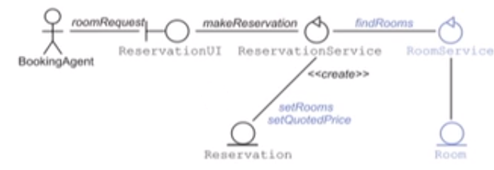
Service and Entity Components
An Entity component will often have a corresponding Service component
A service object will often control its corresponding entity object
A service object can delegate to another service object

Slide 13
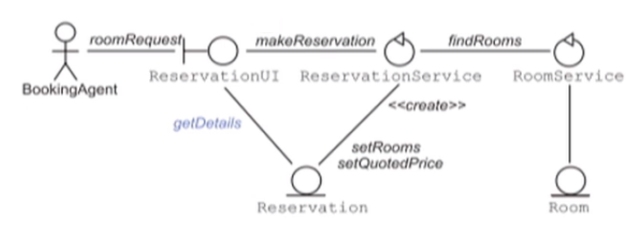
Boundary and Entity Components
A Boundary component can often retrieve the attributes of an Entity component

Slide 14
Describing the Robustness Analysis Process
Select a use case
Construct a Communication diagram or a Sequence diagram that satisfies the activities of the use case
Identify Design components that support the activities of the use case
Draw the associations between these components
Label the associations with messages
Convert the Communication diagram into a Sequence diagram, or vice versa, for an alternative view (optional)

