Slide 1
Module 8 (Part-2):
Transitioning from Analysis to Design Using Interaction Diagrams

Slide 2
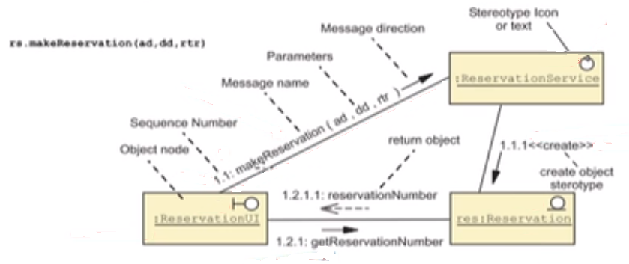
Identify the Elements of a Communication Diagram
A UML Communication diagram is composed of the following elements:

Slide 3
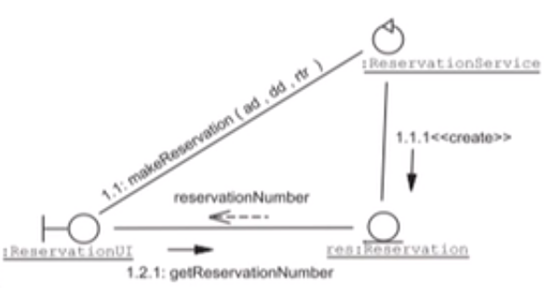
Identifying the Elements of a Communication Diagram
A variation of the previous Communication Diagram:

Slide 4
Identifying the Elements of a Communication Diagram
A message can include:
A message name
A direction arrow
An solid arrowhead is a synchronous message
An open arrowhead is an asynchronous message
A sequence number describing the order of the message
A list of parameters passed to the receiving object
A guard condition indicating a conditional message
A return parameter

Slide 5
Creating Communication Diagram
Select an appropriate use case
Place the actor in the Communication diagram
Analyze the Use Case Form or the Activity Diagram for the use case.
For every action in the use case:
Identify and add a Boundary Component
Identify and add a Service Component
Identify and add an Entity Component
Identify and add further Interactions, discovering new Methods, Boundary, Service and Entity Components

Slide 6
Step -1 - Place the Actor in the Diagram
Place the actor int the Communication Diagram:

Slide 7
Step 2a - Identify Boundary Components
BookingAgent makes a room request passing the arrival date (ad), departure date (dd), requested types of room (rtr):

Slide 8
Step 2b - Identify Service Components
The ReservationUI boundary object uses ReservationService object to make the Reservation:

Slide 9
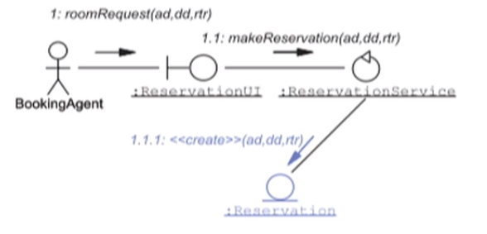
Step2c - Identify Entity Components
The makeReservation method in the ReservationService object creates the Reservation entity object:

Slide 10
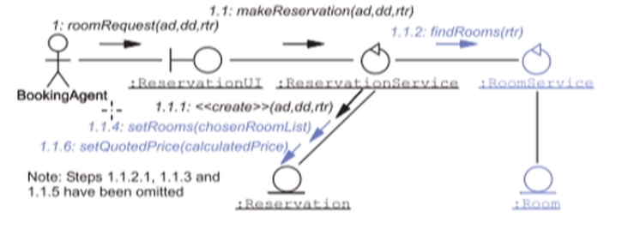
Step 2d - Identify Additional Interactions
The makeReservation method uses the findRoom method to find rooms of the required type. After finding and choosing free rooms (not shown), the setRooms method assigns the rooms to the Reservation. The calculated price (not shown) is assigned to the Reservation:

Slide 11
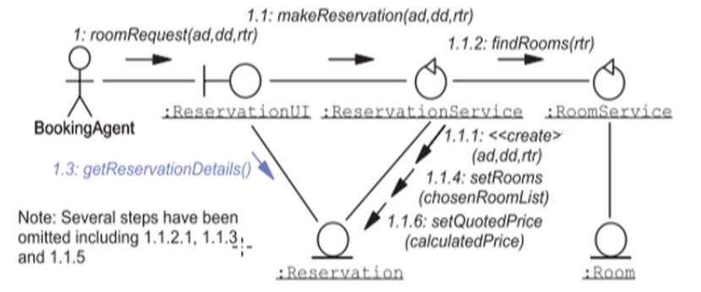
Step 2d - Identify Additional Methods
The makeReservation method of the ReservationService object returns the Reservation object (not shown) to the ReservationUI. The roomRequest method of ReservationUI then calls the getReservationDetails method of the Reservation object, which returns the details of the reservation. These will then be notified to the booking agent (not shown):

Slide 12
Communication Diagram Examples
The following two Communication Diagrams show a more detailed view of the CreateReservation:
Primary (successful) scenario
Secondary (unsuccessful) scenario
Rooms offered are rejected by the booking agent
The finer details has been omitted, to reduce complexity

Slide 13
Communication Diagram Example 1

Slide 14
Communication Diagram Example 2

Slide 15
Sequence Diagrams
Provide a different perspective of the interactions between objects
Can be used instead of Communication Diagrams
Can be converted to or from Communication Diagrams
Prove to be more useful for developers
Highlight the time ordering of the interactions
The next section describes UML Sequence Diagrams

Slide 16
Identifying the Elements in a Sequence Diagram

Slide 17
Fragments
Sequence Diagrams support a Fragment notation. The used of fragments include:
Showing sequence loops
Showing alternative paths
Allowing two or more scenarios to be shown on one diagram
Showing a reference to another detailed Sequence diagram fragment
Allowing you to break up a large diagram into several smaller diagrams
The following slide show examples of the Fragment notation

Slide 18
Fragment Examples

Slide 19
Sequence Diagram Examples
The following three Sequence Diagrams show a more detailed view of CreateReservation:
Primary (successful) scenario and a secondary (unsuccessful) scenario in one diagram using an alt fragment
Secondary (unsuccessful) scenario where rooms offered are rejected by the booking agent
A fragment Sequence Diagram showing the finer details for the GetReservationDetails fragment, and includes a loop fragment
The final detail has been hidden in fragments

Slide 20
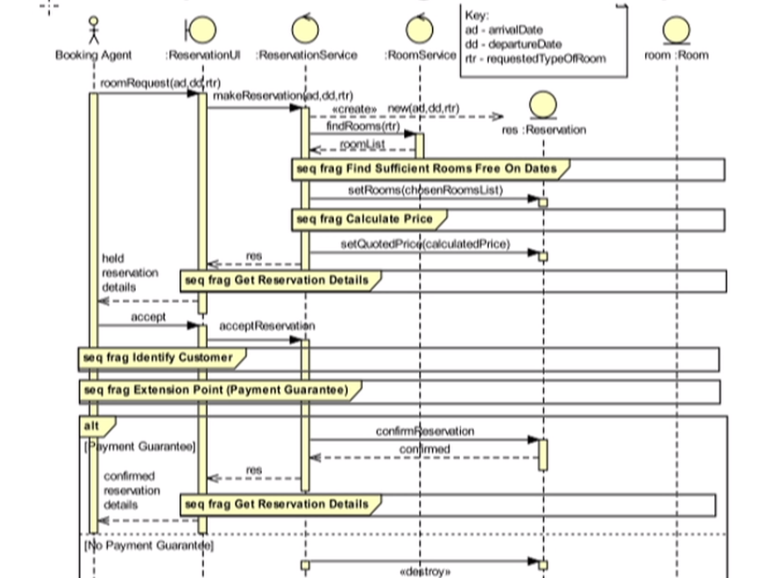
Sequence Diagram Example 1

Slide 21
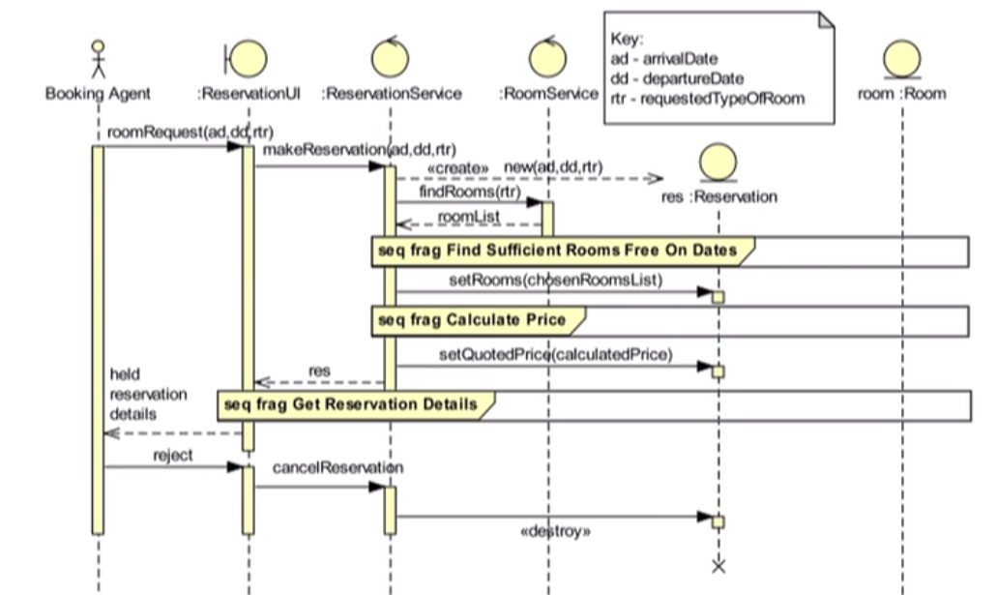
Sequence Diagram Example 2

Slide 22
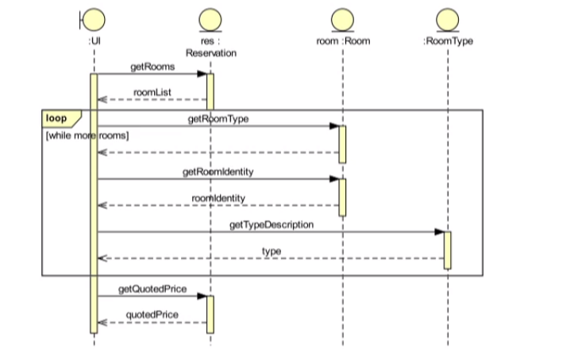
Sequence Diagram Example 3

Slide 23
Summary
Interaction Diagrams are used to identify design components that satisfy a use case
Object interactions can be visualized with a UML
Communication Diagram
Sequence Diagram

