Slide 1
Module 9:
Modeling Object State Using State Machine Diagrams

Slide 2
Objectives
Upon Completion of this module, you should be able to:
To model the Object State
To describe the essential elements of the UML State Machine diagram

Slide 3
Process Map

Slide 4
Introducing Object State
State is "1a: mode or condition of being" (Webster)
There are two ways to think about object state:
The state of an object is specific collection of attribute values for the object
The state of an object describes the behavior of the object relative to external stimuli
This module considers the second definition

Slide 5
Identifying the Elements of a State Machine Diagram

Slide 6
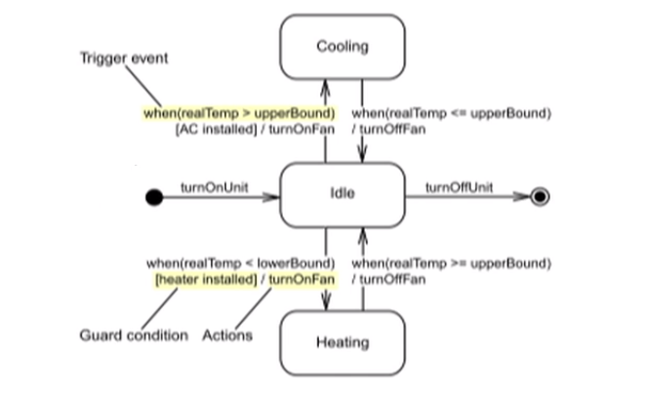
State Transitions
A state transition represents a change of state at runtime

Slide 7
Internal Structure of State Nodes
State nodes represents a state of a single object at runtime
"Entry" event specifies actions upon entry into the state
"Exit" event specifies action upon exit from the state
"Do" event specifies ongoing actions
You can also specify specific events with corresponding actions

Slide 8
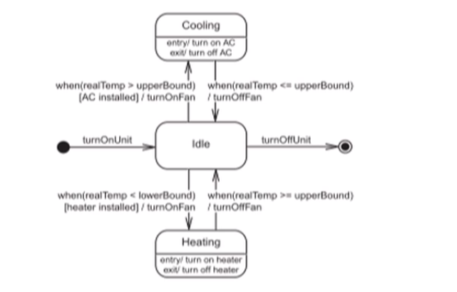
Complete HVAC State Machine Diagram
An Activity diagram must start with a Start node and end with a Stop node. Flow of control is indicated by the arrows that link the activities together.

Slide 9
Step 1 - Start with the Initial and Final States

Slide 10
Step 2 - Determine Stable Object States

Slide 11
Step 3 - Specify the Partial Ordering of States

Slide 12
Step 4 - Specify the Transition Event and Actions

Slide 13
Step 5 - Specify the Actions within a State

Slide 14
After Trigger Event
Events that should occur after a period of time are shown by using the after trigger event
To fire a transition after 10 minutes, specify the event on the transition as after (10 mins)
Thus event is often used for timeouts

Slide 15
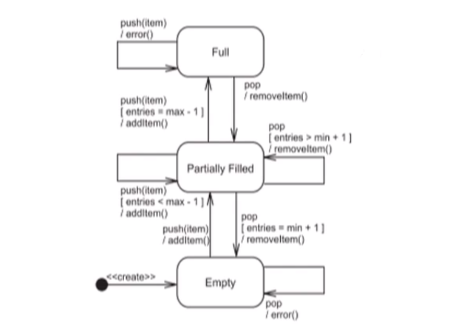
Self Transition
A self transition is a state transition with the same state for the source and the destination of the transition

Slide 16
Junction
In UML, a Junction can be used to simplify diagrams by breaking the transition into several fragments, thereby reducing the duplication of trigger events, guards, and actions
The following example shows the order of state transitions, order of events, evaluation of guards, and actions

Slide 17
Junction Example

Slide 18
Choice
In UML, a Choice is used to simplify diagrams by breaking the transition into several fragments, thereby reducing the duplication of trigger events, guards, and actions. Choice also enables dynamic evaluation of the guards, after the previous transition fragment action are executed
The following example shows the order of state transitions, order of events, evaluation of guards, and actions

Slide 19
Choice Example

Slide 20
Summary
An object might have states that define unique behaviors for the object
The State Machine diagram provides a mechanism for modeling the state and transitions of an object

