Slide 1
Module 10:
Applying Design Patterns to the Design Model

Slide 2
Objectives
Upon Completion of this module, you should be able to:
Define the essential element of a software pattern
Describe the Composite pattern
Describe the Strategy Pattern
Describe the Observer Pattern
Describe the Abstract Factory Pattern
Describe the State Pattern

Slide 3
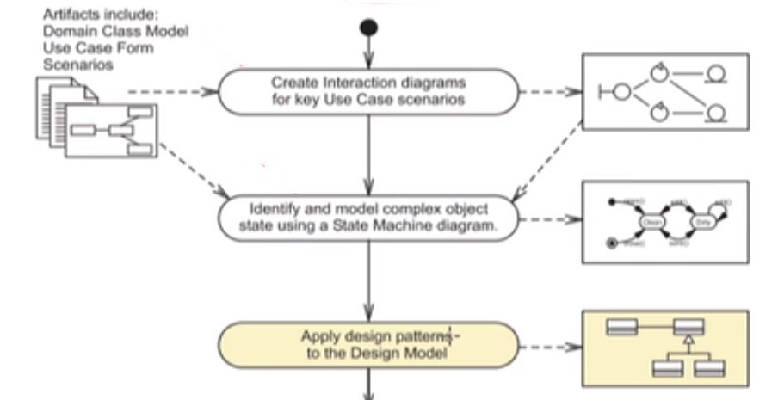
Process Map

Slide 4
Explaining Software Patterns
A software pattern is a "description of communicating objects and classes that are customized to solve a general design problem in a particular context."
-- (Gramma, Helm, Johnson, and Vlissides page 3)
Inspired by building architecture patterns
Essential elements of a software pattern:
Pattern Name
Problem
Solution
Consequences

Slide 5
More complete reference
https://softwaredesignpatterns.azurewebsites.net/

