Slide 1
Module 11:
Introducing Architectural Concepts and Diagrams

Slide 2
Objectives
Upon Completion of this module, you should be able to:
Distinguish between architecture and design
Describe tiers, layers, and systemic qualities
Describe the Architecture workflow
Describe the diagrams of the key architecture views
Select the Architecture type
Create the Architecture workflow artifacts

Slide 3
Process Map

Slide 4
Justifying the Need for the Architect Role
Why is it that software engineering is now employing people in this role? Because of two crucial changes:
Scale
Distribution

Slide 5
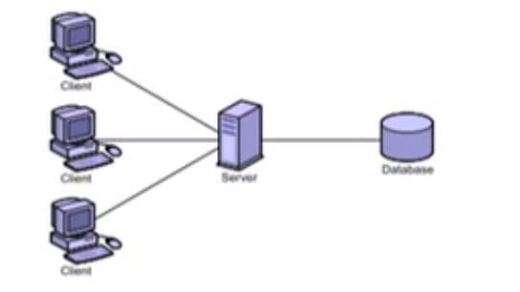
Risks Associated with Large-Scale, Distributed Enterprise Systems
Minimally distributed systems (such as client-server)

Slide 6
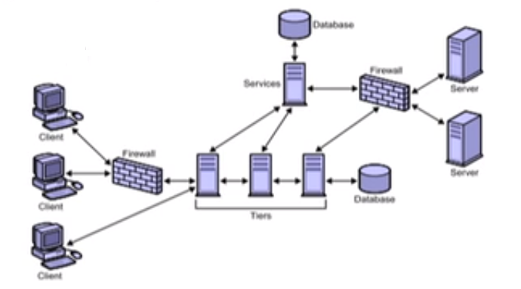
Risks Associated with Large-Scale, Distributed Enterprise Systems
Highly distributed systems
Web
Business
Integration

Slide 7
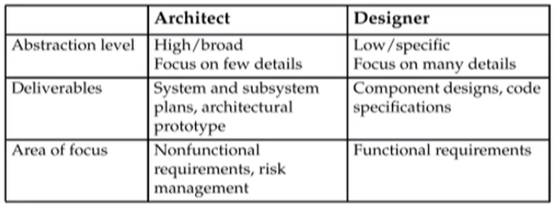
Distinguishing between Architecture &Design
The table below shows how architects differ from designers

Slide 8
Architectural Principles
Separation of Concerns
Dependency Inversion Principle
Separate volatile from stable components
Use component and interfaces simple and clear
Keep remote component interfaces coarse-grained

Slide 9
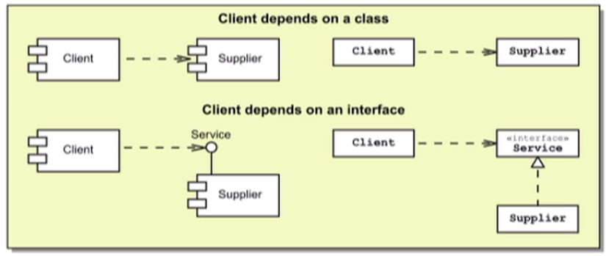
Dependency Inversion Principle
"Depend on abstractions. Do not depend on concretions."
-- (Knoernschild page 12)

Slide 10
Architectural Patterns and Design Patterns
An architect plans systems using a pattern-based reasoning process
An architect must be familiar with a variety of pattern catalogs to be effective
Types of patterns:
Design patterns define structure and behavior to construct effective and reusable OO software components to support functional requirements
Architectural patterns define structure and behavior for systems and subsystems to support nonfunctional requirements

Slide 15
Systemic Qualities
"The strategies, tools, and practices that will deliver the requisite quality of service across the tiers and layers."
--(SunTone Architecture Methodology page 11)
Manifest - Addresses the qualities reflected in the end-user experience
Operational - Addresses the qualities reflected in the execution of the system
Developmental - Addresses the qualities refected in the planning, cost, and physical implementation of the system
Evolutionary - Addresses the qualities reflected in the long-term ownership of the system

Slide 16
Exploring the Architecture Workflow
The Architecture model is essential to the creation of the Solution model:

Slide 17
Introducing the Architecture Workflow
Select an architecture type for the system
Create a detailed Deployment diagram for the architecturally significant use cases
Refine the Architecture model to satisfy the NFRs
Create and test the Architecture baseline
Document the technology choices in a tiers and layers Package diagram
Create an Architecture template from the final, detailed Deployment diagram

Slide 18
Example Design Model

Slide 19
Example Architecture Template

Slide 20
Example Solution Model

Slide 21
Architectural Views
The views of the Architecture model take many forms. Some elements (such as risk mitigation plans) are documented with text. Others can be recorded using UML diagrams:
Package Diagrams
Component Diagrams
Deployment Diagrams

Slide 22
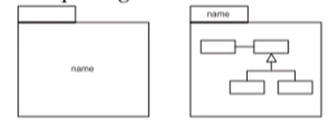
Identifying the Elements of a Package Diagram
An UML package diagram show dependencies between packages, which can hold any UML element
The UML package notation:
The package name an be placed in the body box or in the name box
You can place any UML entity in a package, including other packages (nested containment)

Slide 23
Example Package Diagram

Slide 24
An Abstract Package Diagram

Slide 25
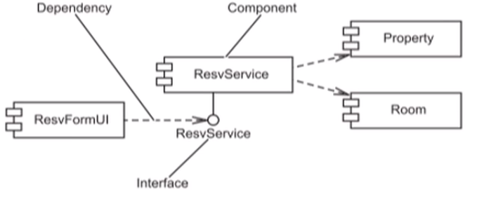
Identifying the Elements of a Component Diagram
A UML Component Diagram is composed of the following elements:

Slide 26
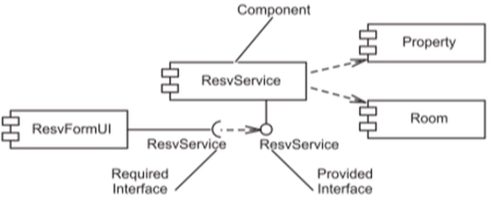
Identifying the Elements of a Component Diagram
Notation for required interfaces in UML 2:

Slide 27
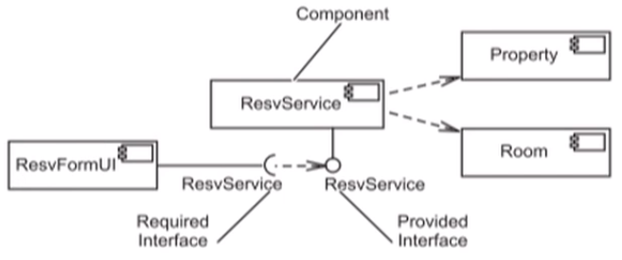
Identifying the Elements of a Component Diagram
Component notation in UML 2:

Slide 28
Characteristics of a Component
A component represents any software unit
A component can be large and abstract
A component can be small
A component might have an interface that it exports as a service to other components
A component can be a file, such as a source code file, an object file, a complex executable, a data file, HTML or media files, and so on

Slide 29
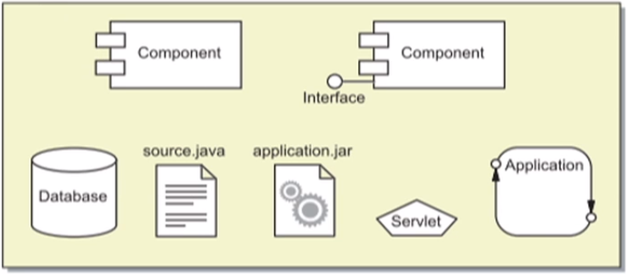
Types of Components
A component is any physical software unit:

Slide 30
Example Component Diagrams
Component Diagrams can show software dependencies. This example shows an RMI dependency:

Slide 31
Example Component Diagrams
Component diagrams an show software dependencies. This example shows a Web Service dependency:

Slide 32
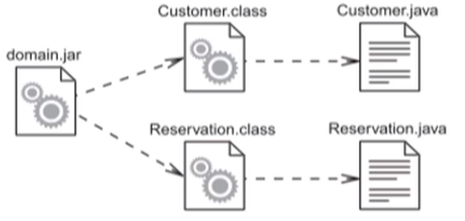
Example Component Diagrams
Component Diagrams can represent build structures:

Slide 33
Identifying the Elements of a Deployment Diagram

Slide 34
The Purpose of a Deployment Diagram
Hardware nodes can represent any type of physical hardware
Links between hardware nodes indicate connectivity and can include the communication protocol used between nodes
Software components are placed within hardware nodes to show the distribution of the software across the network

Slide 35
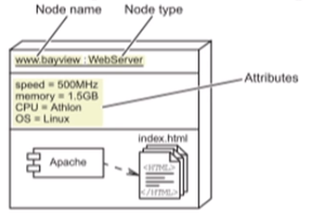
Types of Deployment Diagrams
There are two forms:
A descriptor Deployment Diagram shows the fundamental hardware configuration
An instance Deployment Diagram shows a specific hardware configuration. For example:

Slide 36
Selecting the Architecture Type
The architecture you use depends on many factors, including:
The platform constraints in the system requirements
The modes of user interaction
The persistence mechanism
Data and transactional integrity

Slide 37
Selecting the Architecture Type
There are hundreds of successful software architectures. Here are a few common types:
Standalone Application
Client/Server (2-Tier) Application
N-Tier Applications
Web-Centric N-Tier Application
Enterprise N-Tier Application

Slide 38
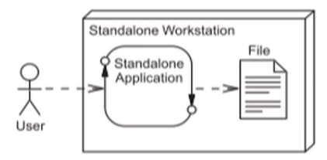
Standalone Applications
No external data sources (All application data exists on a file server)
No network communication (All application components exist on one machine)

Slide 39
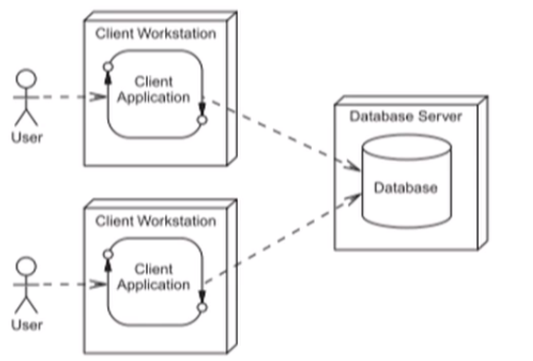
Client/Server (2-Tier) Applications
Thick client (with business logic in the client tier)
Data store manages data integrity

Slide 40
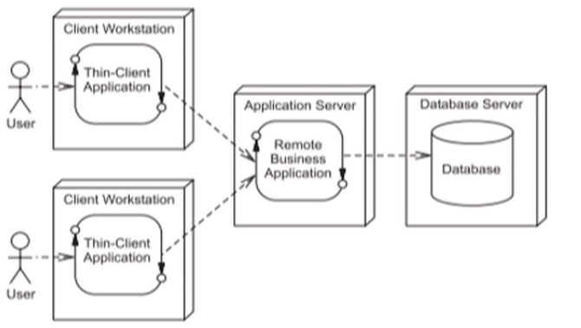
N-Tier Applications
Thin client (Business logic is in the application server)
Application Server manages data integrity

Slide 41
_

Slide 42
_

Slide 43
Enterprise (N-Tier) Architecture Type
Two thin clients:
Web Browser for Internet users
GUI thin client for internet users
Web Application server provides presentation logic
Application server provides business logic

Slide 44
Hotel Reservation System Architecture

Slide 45
Creating The Detailed deployment Diagram
Design the components for the architecturally significant use cases
Place design components into the Architecture Model
Draw the detailed Deployment Diagram from the merger of the design and infrastructure components

Slide 46
Example Detailed Deployment Diagram

Slide 47
Creating the Architecture Template
Strip the detailed Deployment Diagram to just one set of Design components: Boundary, Service, and Entity
Replace the name of the Design Component with the type (for example, ResvSvcImpl_Stub become ServiceImpl_Stub)

Slide 48
Example Architecture Template

Slide 49
Creating the Tier an Layers Package Diagram
For each tier:
Determine what application components exist
Determine what technology APIs, communication protocols, or specifications are required that the components require
Determine which container products to use
Determine which operating system to use
Determine what hardware to use

Slide 50
Tiers and Layers Diagram for the HotelApp

Slide 51
Tiers and Layers Diagram for the Hotel System's Web Presence

Slide 52
Summary
Difference between architecture and design
Design produce components to implement a use case
Architecture provides a template into which the designed components are realized
You can model the architecture using:
Deployment Diagrams
Components Diagrams
Packages
Tiers an Layers

