Slide 1
Module 12:
Introducing the Architectural Tiers

Slide 2
Objectives
Upon Completion of this module, you should be able to:
Describe the concepts of the Client and Presentation Tiers
Describe thee concepts of the Business Tiers
Describe the concept of the Resource and Integration Tiers
Describe the concept of the Solution Model

Slide 3
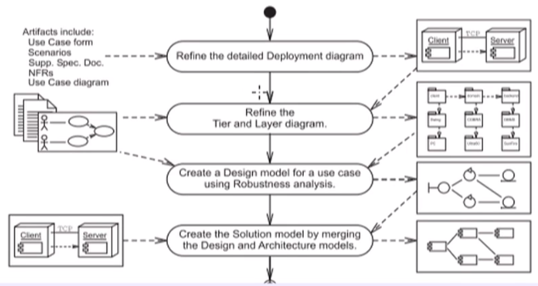
Process Map

Slide 4
Introducing the Client an Presentation Tiers
The Client and Presentation Tiers primarily contain:
Controller Components:
Control the input from the boundary
Perform input sanity checking
Call business logic methods
Dispatch view components
View Components:
Retrieve data required by the view
Prepare the view in a format suitable for the recipient
Add client-side sanity checking (optional)

Slide 5
Boundary Interface Technologies
The primary Boundary Interface types are:
Graphical user interface (GUI)
Web user interface (Web UI)
Machine or device interface (for example, Web services)
Other types of Boundary Interfaces include:
Touchpads
Direct manipulation
Joystick
Interactive voice recognition
Keypads
Command line

Slide 6
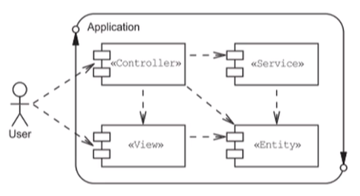
Generic Application Components
There are four fundamental types of application components:

Slide 7
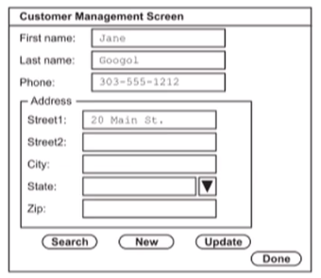
GUI Screen Design
An example GUI screen design:

Slide 8
Customer GUI Component Hierarchy

Slide 9
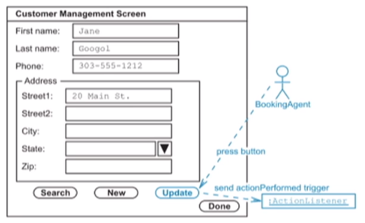
GUI Event Model
JavaTM technology uses an event-listener mechanism:

Slide 10
GUI Listeners as Controller Elements

Slide 11
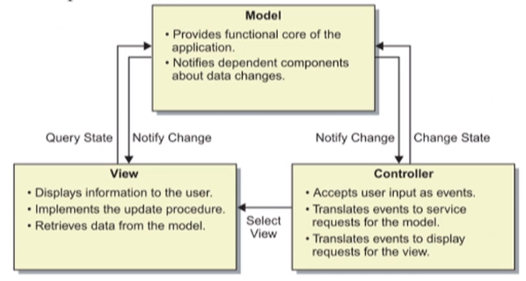
The MVC Pattern
MVC separates Views and Controllers from the Model

Slide 12
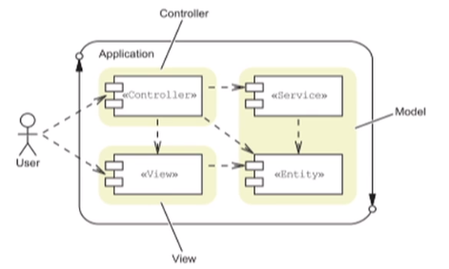
The MVC Component Types
MVC groups Service and Entity components into a single component call Model:

Slide 13
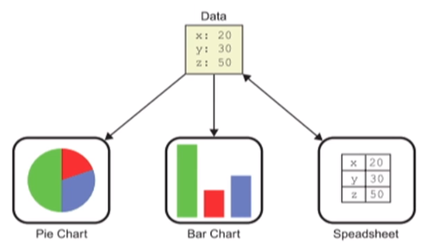
Example Use of the MVC Patterns
Multiple views can be used on the same data:

Slide 14
Overview of the Tiers and Layers Package Diagram

Slide 15
Exploring Web User Interfaces
A Web UI provides a browser-based user interface. Web UIs have the following characteristics:
Perform a few large user actions (HTTP requests)
A single use case is usually broken into multiple screens
There is often a single path through the screens
Only one screen is usually open at a time

Slide 16
Web UI Screen Design
A Web UI trends to be constructed as a sequence of related screens
Each screen is a hierarchy of UI components
A Web UI screen presents the user’s view of the domain model as well as presents the user’s action controls
It is rare that a screen can be reused by multiple use cases

Slide 17
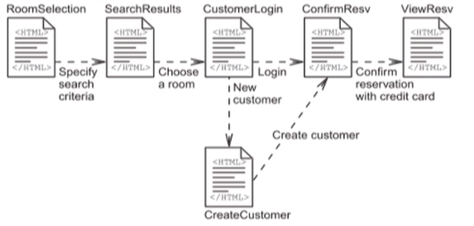
Example Web Page Flow
The Create a Reservation Online (E5) use case can be viewed as a sequence of Web UI screens:

Slide 18
Web UI Event Model
Micro events can be handled by JavaScriptTM
Macro events are handled as HTTP requests from the web browser to the server

Slide 19
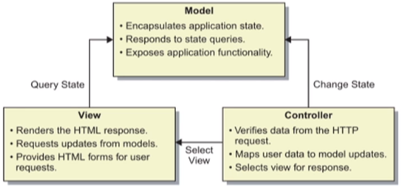
The WebMVC Pattern
WebMVC is based on MVC, but with no Model to View update:

Slide 20
The WebMVC Pattern Component Types

Slide 21
The WebMVC Pattern
The Model 2 architecture use these component:
Java servlets act as a Controller to process HTTP requests:
Verify the HTML form data
Update the business Model
Select and dispatch to the next View
JavaServer PagesTM (JSP) technology acts as the View that are sent to the user
Java technology classes (whether local or distributed) act as the Model for the business services and entities

Slide 22
Overview of the Tiers and Layers Package Diagram

Slide 23
Introducing the Business Tier
The Business tier primarily contains:
Entity components
Service Components
Perform validation of business rules
Perform update on the entity components
The Business tier may be accessed by:
Local components
Remote components, for example:
Remote Method Invocation (RMI)
Web Service protocols

Slide 24
Local Access to a Service Component

Slide 25
Applying Dependency Inversion Principle

Slide 26
An Abstract Version of Accessing a Remote Service

Slide 27
Accessing a Remote Service using RMI

Slide 28
RMI uses Serialization to pass Parameters

Slide 29
The RMI Registry stores Stubs for Remote Lookup

Slide 30
Overview of the Detailed Deployment Diagram

Slide 31
Package Diagram

Slide 32
Exploring the Resource Tier
The Resource tier includes:
Database
File
Web Service
Enterprise Information System (EIS)

Slide 33
Exploring Object Persistence
Persistence is “The property of an object by which its existence transcends time and space.”
-- (Booch OOAD with Apps page 517)
A persistence object is:
An object that exists beyond the time span of a single execution of the application
An object that is stored independently of the address space of the application

Slide 34
Persistence Issues
Here are a few of the persistence issues that must be addressed:
Type of data storage
Database schema that maps to the Domain Model
Integration components
CRUD operations: Create, Retrieve, Update, and Delete

Slide 35
Creating a Database Schema for the Domain Model
Defining the database schema is usually done in two phases:
The logical Entity-Relationship (ER) diagram contains:
The OO entities as tables
The OO entities attributes as field within the tables
The OO associations as relationships between tables
The physical ER diagram takes the logical diagram and adds:
Data types on fields
Indexes on tables
Data integrity constraints

Slide 36
Creating a Database Schema for the Domain Model
The strategy for converting the Domain Model into a logical ER diagram is:
Convert each class into a table
Specify the primary key for each table
Use the association multiplicity to determine the type of ER association

Slide 37
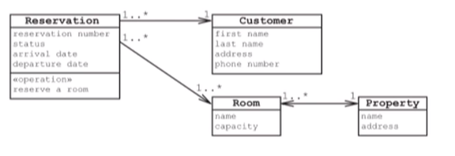
Simplified HRS Domain Model
This example uses a simplified Domain Model:

Slide 38
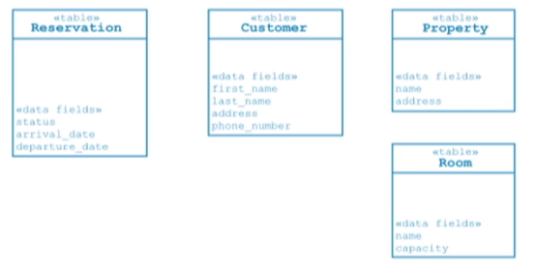
Step 1 – Map OO Entities to DB Tables
Create tables for each entity in the Domain Model:

Slide 39
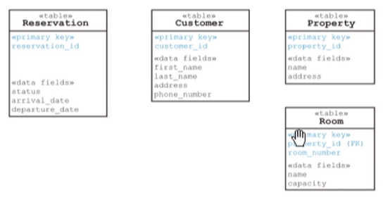
Step 2 – Specify the Primary Keys
Add the primary key field:

Slide 40
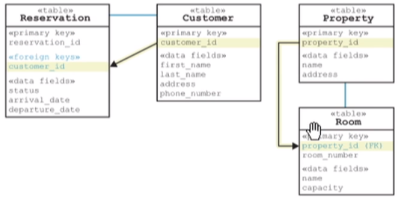
Step 3 – Specify One-to-Many Relationships
Use foreign keys:

Slide 42
Overview of the Detailed Deployment Diagram

Slide 43
Overview of the Tiers and Layers Package Diagram

Slide 44
Exploring Integration Tier Technologies
The Integration tier separates the entity components from the resources.
Resources that require integration are:
Data sources
Enterprise Information Systems (EIS)
Computation Libraries
Message Services
B2B Services

Slide 45
The DAO Pattern
The Data Access Object (DAO) Pattern:
Separate the implementation of the CRUD operations from the application tier
Encapsulates the data storage mechanism for the CRUD operations for a single entity with one DAO component for each entity
Provides an Abstract Factory for DAO components if the storge mechanism is likely to change

Slide 46
The DAO Pattern: Example 1

Slide 47
The DAO Pattern: Example 2

Slide 48
The DAO Pattern

Slide 49
Overview of the Detailed Deployment Diagram

Slide 50
Overview of the Tier and Layers Package Diagram

Slide 51
JavaTM Persistence API
Java Persistence API:
Is an alternative to DAO
Draw on the best ideas from alternative persistence technologies such as Hibernate, TopLink, and Java Data Object (JDO)
Uses a persistence provider such as Hibernate or TopLink
Is a Plain Old Java Object (POJO) persistence API for Object/Relational mapping
Uses an entity manager to manage objects

Slide 52
Java Persistence API Entity Manager
Java Persistence API entity manager can be requested for:
Manage objects by keeping their data in synchronization with database record
Persist or merge unmanaged objects, which makes these objects managed
Find an object using the primary key, which creates an object from the database record

Slide 53
Introducing the Solution Model
The Solution Model is the basis upon which the development team will construct the code of the system solution
The Solution Model is constructed by merging the Design Model into the Architecture Model (Template)

Slide 54
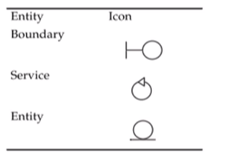
Overview of a Solution Model for GUI Applications
GUI applications use the standard set of design components

Slide 55
A complete Design Model for the Create Reservation use case

Slide 56
A complete Solution Model for the Create Reservation use case

Slide 57
A complete Design Model for the Create Reservation use case

Slide 58
A complete Solution Model for the Create Reservation Online use case

Slide 60
Summary
The Client and Presentation tiers include Boundary View and Controller components
The Business tier includes business services and entity components
The Integration Tier includes components to separate the business entities from resources
The Resource Tier includes one or many data sources such as an R-DBMS, OO-DBMS, EIS, Web Services, or files
The Solution Model provides a view of the software system that can be implemented in code
The Solution Model is created by merging the Design Model into the Architecture Model (Template)

Slide 61
This is the last lesson for Architecture

