Slide 1
Module 13:
Refining the Class Design Model

Slide 2
Objectives
Upon Completion of this module, you should be able to:
Refine the attributes of the Domain Model
Refine the relationships of the Domain Model
Refine the methods of the Domain Model
Declare the constructions of the Domain Model
Annotate method behavior
Create components with interfaces

Slide 3
Process Map

Slide 4
Refining Attributes of the Domain Model
Refining attributes involves the following:
Refining the metadata of the attributes
Choosing an appropriate data type
Creating derived attributes
Applying encapsulation

Slide 5
Refining the Attribute Metadata
An Activity declaration in UML. Class diagram includes the following:
Name
Visibility
Type
Multiplicity
Initial value
Constraint (one of changeable, addOnly, or frozen)

Slide 6
Refining the Attribute Metadata
Syntax:

Slide 7
Choosing an Appropriate Data Type
Choosing a data type is a trade-off of:
Representational transparency
Computational time
Computational space

Slide 8
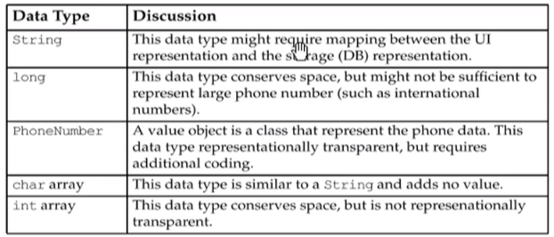
Choosing an Appropriate Data Type
For a phone number attribute:

Slide 9
Creating Derived Attributes
In Analysis, you might have an attribute that you know can be derived from another (more stable) source.
The canonical example is the calculation of a person’s age from their date of birth:

Slide 10
Applying Encapsulation
To apply encapsulation, follow these steps:
Make all attributes private (visibility)
Add public accessor methods for all readable attributes
Add public mutator methods for all writable (non-frozen) attributes

Slide 11
An Encapsulation Example

Slide 12
Refining Class Relationships
There is no clear distinction between Analysis and Design, especially in regards to modeling class associations
Design usually addresses these details:
Type: association, aggregation, and composition
Direction of traversal (also called navigation)
Qualified associations
Declaring association management methods
Resolving many-to-many associations
Resolving association classes

Slide 13
Relationship Types
There are three types of relationships:
Association
Aggregation
Composition
These relationships imply that the related object is somehow tied to the original object (usually as an instance attribute)
There is another type of relationship, Dependency, which states that one object uses another object to do some work, but that there is no instance attribute holding that object

Slide 14
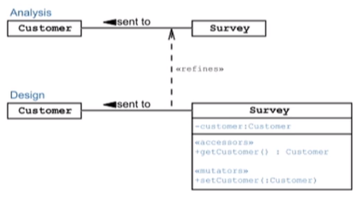
Association
“The semantic relationship between two or more classifications that specifies connections among their instances.”
(OMG page 537)

Slide 15
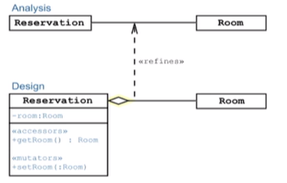
Aggregation
“A special form of association that specifies a whole-part relation between the aggregate (whole) and a component part.”
(OMG page 537)

Slide 16
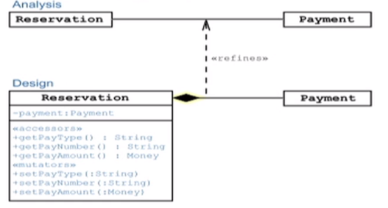
Composition
“A form of aggregation that requires that a part instance be included in at most one composite at a time, and that the composite object is responsible for the creation and destruction of the parts.”
(OMG page 540)

Slide 17
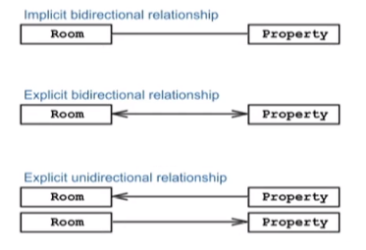
Navigation
A navigation arrow shows the direction of object traversal at runtime.

Slide 18
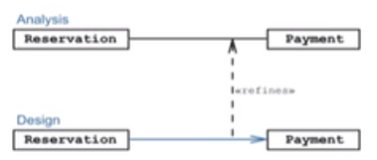
Navigation
Sometimes in analysis, you do not know what direction the software will need to navigate the association. This problem should be resolved in design.
For example:

Slide 19
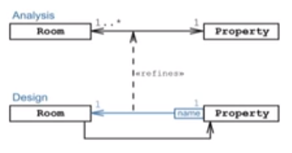
Qualified Associations
In one-to-many or many-to-many associations, it is often useful to model how the system will access a single element in the association
For example:

Slide 20
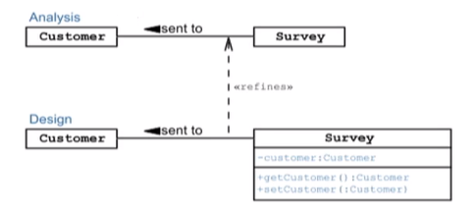
Relationship Methods
Association methods enable the client to access and change association objects. There are three cases: one-to-one, one-to-many, and may-to-many
One-to-many relationship require a single instance variable:

Slide 21
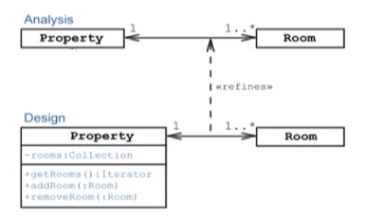
Relationship Methods
One-to-many relationships require the use of collections:

Slide 22
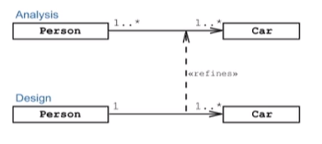
Resolving Many-to-Many Relationships
Managing many-to-many associations is challenging. Consider dropping this requirement at design time

Slide 23
Resolving Many-to-Many Relationships
If the many-to-many association must be preserved, you can sometimes add a class in between that reduce the single many-to-many association to two one-to-many associations
For example:

Slide 24
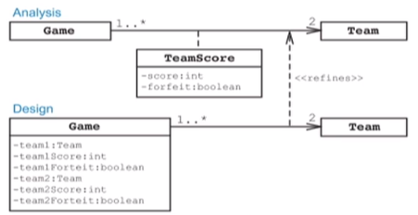
Resolving Association Classes
An association class can only exist in the Analysis Model. It should be resolved into a programmable class at design.

Slide 25
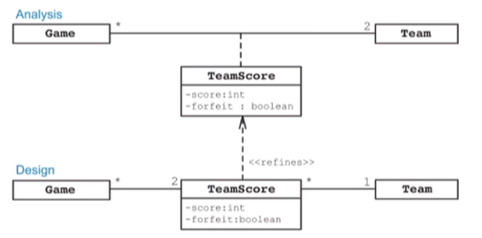
Resolving Association Classes
Alternatively, the association class can placed in between the two primary classes:

Slide 26
Refining Methods
Methods are identified during the following workflows:
CRC Analysis, which determines responsibilities
Robustness analysis, which identifies methods in Service classes
Design, which identifies accessor and mutator methods for attributes and associations
Other types of methods:
Object management
Unit testing, Recovery, Inverse, and Complimentary operations

Slide 27
Refine Methods

Slide 28
Annotating Method Behavior
UML annotations can be attached to each method to document the behavior of the method

Slide 29
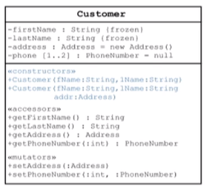
Declaring Constructors
Constructors initialize an object and a syntax similar to methods:

Slide 30
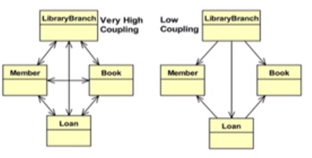
Reviewing Coupling
Ideally, your model should have the lowest coupling while maintaining the FRs and NFRs

Slide 31
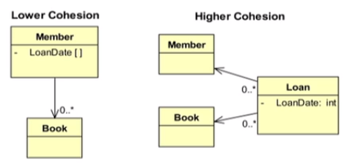
Reviewing Cohesion
Ideally, your model should have the highest cohesion

Slide 32
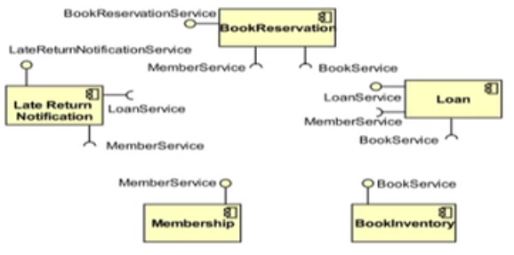
Creating Components with Interfaces
Classes can be grouped into cohesive components with well-defined provided and required interfaces

Slide 33
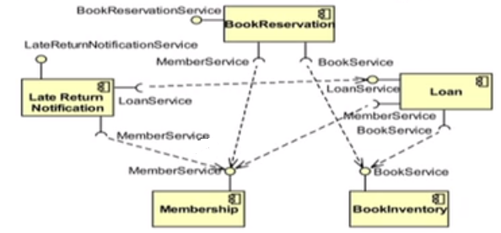
Creating Components with Interfaces
Dependency arrows are not required if you are using the Required Interface notation. However, you may show the arrows as illustrated in the following example:

