Slide 1
Module 14:
Overview of Software Development Processes

Slide 2
Objectives
Upon Completion of this module, you should be able to:
Explain the best practices for OOSD methodologies
Describe the features of several common methodologies
Choose a methodology that best suits your project
Develop an iteration plan

Slide 3
Reviewing Software Methodology

Slide 4
Exploring Methodology Best Practices
Use-case-drive
Systemic-quality-driven
Architecture-centric
Iterative and incremental
Model-based
Design best practices

Slide 5
Use-Case-Driven
“A software system is brought into existence to serve its users.”
(Jacobson USDP page 3)
All software has users (human or machine)
Users use software to perform activities or accomplish goals (use cases)
A software development methodology supports the creation of software that facilitates use cases
Use cases drive the design of the systems

Slide 6
Systemic-Quality-Driven
Systemic quality are requirements on the system that are non-functional or related to the quality of service
Examples include:
Performance – Such as responsiveness and latency
Reliability – The mitigation of component failure
Scalability – The ability to support additional load. Such as more users
Systemic qualities drive the architecture of the software

Slide 7
Architecture-Centric
“Architecture is all about capturing the strategic aspects of the high-level structure of the system.”
(Arlow and Neustadt page 18)
Strategic aspects are:
Systemic qualities drive the architecture components and patterns
Use cases must be fit into the architecture
High-level structure is:
Tiers, such as client, application, and backend
Tier components and their communication protocols
Layers, such as application, platform, hardware

Slide 8
Iterative and Incremental
“Iterative development focuses on growing the system in small, incremental, and planned steps.”
(Knoernschild page 77)
Each iteration includes a complete OOSD life cycle, including analysis, design, implementation, and test
Models and software are build incrementally over multiple iterations
Maintenance is simply another iteration (or series of iterations)

Slide 9
Model-Based
Models are the primary means of communication between all stakeholders in the software project
Type:
Textual documents
UML diagrams
Prototypes
Purposes:
Communication
Problem Solving
Proof-of-concept

Slide 10
Design best Practices
Understanding and applying design-level best practices can improve the flexibility and extensibility of a software solution.
These best practices include the following:
Design principles
Software patterns
Refactoring
Sun Blueprints (http://www.sun.com/blueprints/)

Slide 11
Surveying Several Methodologies
This module describes the following methodologies:
Waterfall
Unified Software Development Process (USDP or just UP)
Rational Unified Process (RUP)
Scrum
eXtreme Programming (XP)

Slide 12
Waterfall
Waterfall uses a single phase in which all workflows proceed in a linear fashion
This methodology does not support iterative development
This methodology works best for a project in which all requirements are known at the start of the project and requirements are not likely to change
Some government contracts might require this type of methodology
Some consulting firms use this methodology in which each workflow is contracted with a fixed-price bid

Slide 13
Waterfall

Slide 14
Unified Software Development Process
The Unified Software Development Process (USDP) is the “open” version of Rational’s methodology created by Booch, Jacobson, and Rumbaugh. This is also called the Unified Process (UP)
Four phases:
Inception – Creates a vision of the software
Elaboration – Most use cases are defined plus the system architecture
Construction – The software is built
Transition – Software moves from Beta to Production
There can be multiple iteration per phase

Slide 15
Unified Software Development Process

Slide 16
Rational Unified Process
RUP is the commercial version of the UP methodology created by Booch, Jacobson, and Rumbaugh
RUP is UP with the support of Rational’s tool set
These tools manage the phases, workflows, and artifacts throughout the project life cycle

Slide 17
Rational Unified Process

Slide 18
Scrum
Scrum is an iterative and incremental development framework that is often used in conjunction with agile software development. The key features are:
Each Sprint produces a deliverable increment of the software
Each Sprint is typically 15 to 30 days
A subset of features are moved from the Product backlog to the Sprint backlog at the beginning of each Sprint
The requirements in the Sprint backlog are developed during Sprint
Sprint progress is retrieved every 24 hours in a daily Scrum
The Scrum framework requires team-oriented responsibilities

Slide 19
Scrum

Slide 20
eXtreme Programming
“XP nominates coding as the key activity throughout a software project.”
--(Eric Gamma, forward to Beck’s XP book, page xiii)
Here are a few key ideas:
Pair programming – If code reviews are good, then review code all the time
Testing – If testing is good, then test all the time, even the customers
Refactoring – If design is good, then make it part of everybody’s daily business
Simplicity – If simplicity is good, then always leave the system with the simplest design

Slide 21
eXtreme Programming

Slide 22
Choosing a methodology
There are a number of factors that guide in the choice of a methodology for a given project
Company culture – Process-oriented or Product-oriented
Make up of team – Less experienced developers might need more structure and people have distinct job roles
Size of project – A larger project might need more documentation (communication between stakeholders)
Stability of requirements – How often requirements change

Slide 23
Choosing Waterfall
When to use:
Large teams with distinct roles
Choose waterfall when the project is not risky
Issues:
Not resilient to requirements changes
Tends to be documentation heavy

Slide 24
Choosing UP
When to use:
Company culture is process-oriented
Teams with members that have flexible job roles
Medium-to-large-scale projects
Requirements are allowed to change
Issues:
Tends to be process and documentation heavy
This is overkill for small projects

Slide 25
Choosing RUP
When to use:
Same as UP
Your company owns Rational’s tool set
Issues:
Same as UP
Tool set learning curve
Tools lock the team into a process

Slide 26
Choosing Scrum
When to use:
Priority of the requirements are constantly changing
When you need to deliver a working incremental of the software every 30 days
Issues:
Requires a committed team
Primary focus is on the functional requirements for each Sprint. Non-functional requirements might be not be considered adequately

Slide 27
Choosing XP
When to use:
Company culture permits experimentation
Small, close (proximity) team with flexible work spaces
Team must have as many experienced developers as inexperienced
Requirements change frequently
Issues:
Tends to be documentation light

Slide 28
Project Risks and Constraints
Project Risks and Constraints are often managed by the Project Architect
Project Risks and Constraints should be assessed during the initial stages of the development process

Slide 29
Project Constraints
Project development constraints are often confused with NFRs, which are the runtime constraints of the system
Typical project constraints are:
Project must be developed on a specific platform
Project requires specific technologies
Project has a fixed deadline
System interacts with specific external systems

Slide 30
Project Risks
Every project involves level of risk
Any situation or factor that could lead to an unsuccessful conclusion to a project defines a risk
Each constraint usually affects several risk factors, some positively and some negatively

Slide 31
Project Risks
The five main risk areas are:
Political
Technological
Resources
Skills
Requirements

Slide 32
Producing an Iteration Plan
Iteration plans are mainly applicable to iterative and incremental development processes
These plans determine the order in which the software components are developed
If you are using a use-case-driven methodology or a similar methodology, consider each use case based on priority, risk, and dependencies
The iteration plan might be documented in detail early in the project and rigidly followed or might be loosely planned and open for change as the project progresses

Slide 33
Prioritize Use Cases
Use cases, user stories, high-level FRs, and features are often categorized based on priority
A common prioritization method is the MuSCoW prioritization technique, where priorities are defined as:
Must have this
Should have this, if at all possible
Could have this if it does not affect anything else
Won’t have this time, but would like to include in the future

Slide 34
Assesses Use Case Risk
Consider each use case based on risk. These risk factor considerations should include:
Complexity of the use case
Interfaces to external devices and system

Slide 35
Architectural Significance
Use cases are architecturally significant if they have project-critical NFRs
These use cases require the architect to choose an architecture that satisfies those NFRs

Slide 36
Architectural Baseline
An architectural baseline is a subset of the system requirements that are:
Realized in code early in the project
Tested to prove that the chosen architecture satisfies major NFRs
The baseline code includes architecturally significant use cases
This process of testing these architecturally significant use cases is often called “Architectural Proof-of-Concept.”
In the Unified Process (UP, the architectural baseline must be completed at the end of the elaboration phase

Slide 37
Timeboxing
Each iteration in an iterative and incremental development process has a fixed time duration
Key features:
The iteration completes on schedule
Unfinished use cases are rescheduled to the next iteration
You should avoid continuous rescheduling of a specific use case (skidding)

Slide 38
80/20 Rule
In an iterative and incremental development process, you do not have to fully understand every aspect before moving to the next step.
The 80/20 rule can be applied. For example:
For 20% of the effort, you can understand 80% of the details
For 20% of the effort, your specification can achieve 80% accuracy
Missing details and accuracy are found in the subsequent iterations for a fraction of the effort
This rule works only if the software that you build is flexible

Slide 39
Producing an Iteration Plan
Iteration plan contains the use cases that you intend to develop in each iteration
The criteria for assessment includes the following items:
Use case priority
Use case risk
Architectural significance
Estimated time to develop a use case
Dependency on other use case
The Use Case Form and the Supplementary Specification Document contains this information

Slide 40
Producing an Iteration Plan

Slide 41
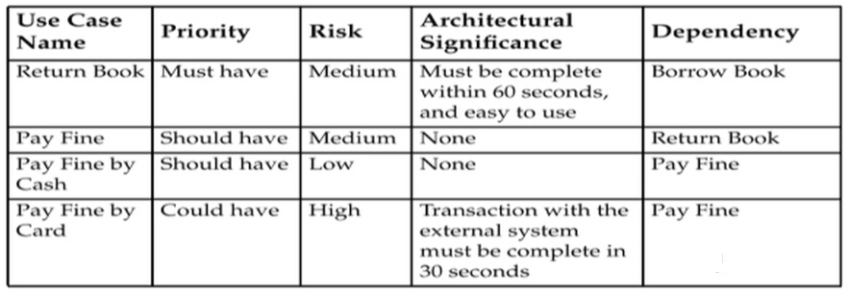
Producing an Iteration Plan
Example Assessment Criteria

Slide 42
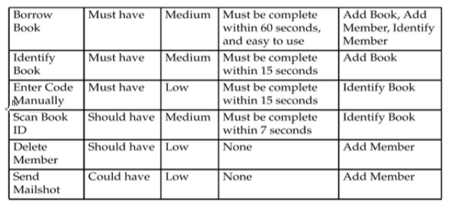
Producing an Iteration Plan
Example Assessment Criteria

Slide 43
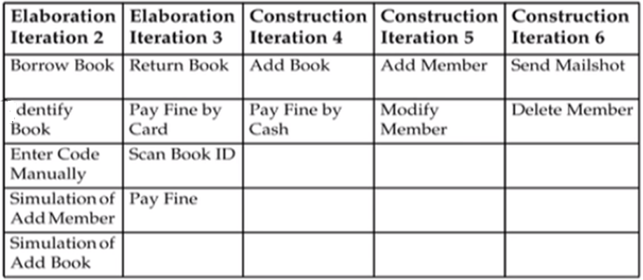
Example Iteration Plan
Here is a sample interpretation of an iteration plan

Slide 44
Summary
In this module, we reviewed:
Iterative and incremental development
Architecture-centric development
Project risk and constraints
Developing an iteration plan based on a use case’s:
Priority
Risk
Architectural Significance
No one methodology fits every organization or project. You can create your own methodology by adapting an existing methodology to suit your requirements and by following the best practices

