Slide 1
Module 15:
Overview of Frameworks

Slide 2
Objectives
Upon Completion of this module, you should be able to:
Define a framework
Describe the advantages and disadvantages of using frameworks
Identify several common frameworks
Understand the concepts of creating own business domain framework

Slide 3
Description of Frameworks
A software framework is a re-usable software infrastructure that can be extended and configured to provide a specific software solution
A software framework provides extension points in the framework where the application programmers may make additions or modifications for functional requirements
This infrastructure can include components, APIs, scripts, supporting applications, configuration files

Slide 4
Description of Frameworks
A framework can provide the infrastructure for:
One or more tiers
  For example, web presentation, business services, entities, and integration tiers
A specific business domain
  For example, insurance, banking, or oil exploration
A shared business domain requirement
  For example, resource allocation, event management, or billing

Slide 5
Description of Frameworks
Customization of a framework is done by:
Extending framework classes or implementing framework interfaces
  Your classes may be less coherent
  Your classes may be more difficult to test outside of the framework
Informing the framework of the plain old Java (POJO) classes it must managed by using configuration files or annotations
  POJOs tend to be more coherent
  POJOs can be easier to test outside of the framework

Slide 6
List of common Frameworks
Ruby on Rail
Spring
Java Server Faces (JSF)
Hibernate
Struts
Microsoft .NET
Structs 2
Angular
ReactJS

Slide 7
Advantages and Disadvantages of using Frameworks
Advantages include:
  Developers can focus on the new business problem and not the infrastructure problems, or common business aspects
  Frameworks usually include good OO practices and patterns
  Once you have gained experience with a framework, code is easier to write and support
  Easier hand-over project to someone well-trained with the framework
  Might have third-party supporting tools

Slide 8
Advantages and Disadvantages of using Frameworks
Disadvantages include:
  Your code may become bloated due to the one-size-fits all approach of the framework
  Frameworks may be difficult to learn
  You are restricted by the infrastructure and cannot usually modify the infrastructure files
  Changing to an alternative framework may be difficult

Slide 9
Building Framework
A generic framework can be build for a specific business domain
For example an insurance company could create a generic insurance framework that would support any insurance domain product. For example:
  Pet insurance
  Car insurance
  Life insurance
  Property Insurance
  Public liability insurance

Slide 10
Building Framework
The following examples show two alternative approaches to building a generic framework for an insurance domain with a specialization domain of Pet insurance:
  Example 1: Show a framework based on abstract classes
  Example 2: Show a framework based on interfaces and abstract classes
There are other possible approaches to building framework

Slide 11
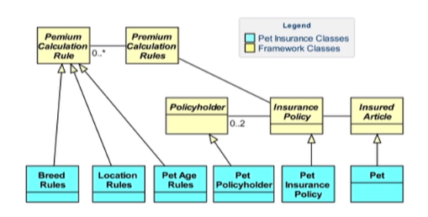
Domain Specific Framework Example 1

Slide 12
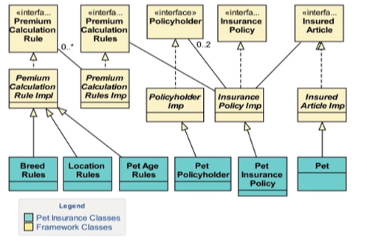
Domain Specific Framework Example 2

Slide 13
Domain Neutral Frameworks
Domain neutral frameworks are often used for subsystems
These frameworks contain common features required by a variety of different domain. For example:
  A used car sales system could use a trading framework and a billing system framework
  A human resource system could use a resource allocation framework

Slide 14
Domain Neutral Frameworks
It is possible to find more generic patterns, which are often called analysis pattern
  For example one such pattern is Party (Person or Company), Place, Thing, Event. This pattern forms the basis of event planning or resource scheduling
  However these may be far too abstract and generic to be of benefits

Slide 15
Advantages and Disadvantages of Building Frameworks
The advantages of building a framework include:
A reduction in cost and development time for each specific domain version using the framework
May result in providing a competitive advantage
Developer can focus on the differences between the specific domain and the framework
Frameworks usually include good OO practices and patterns

Slide 16
Advantages and Disadvantages of Building Frameworks
The disadvantages of building a framework include:
Can be expensive to build
Requires an excellent knowledge of all the domains that the framework will be used for

